Slide 1
Lecture 5: Convolutional Neural Networks
Lecture 5 -
1

Slide 2
Administrative
Assignment 1 due Thursday April 20, 11:59pm on Canvas
Assignment 2 will be released Thursday
Lecture 5 -
1

Slide 3
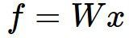
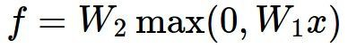
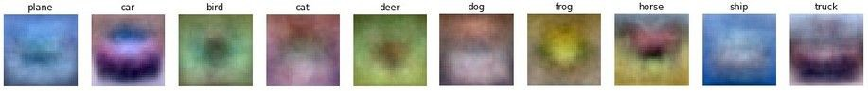
Last time: Neural Networks
Linear score function: 2-layer Neural Network
x
h
W1
W2
s
3072
100
10
Lecture 5 -
3
April 18, 2017₃

Slide 4
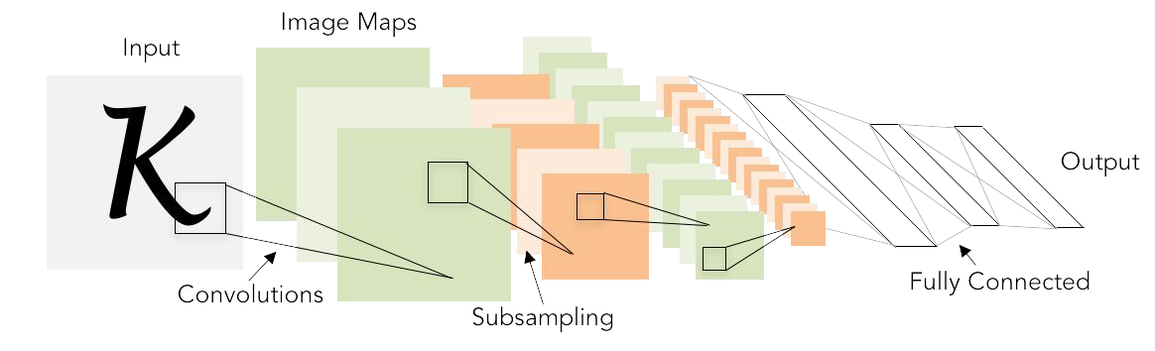
Next: Convolutional Neural Networks
Illustration of LeCun et al. 1998 from CS231n 2017 Lecture 1
Lecture 5 -
4
April 18, 2017₄

Slide 5
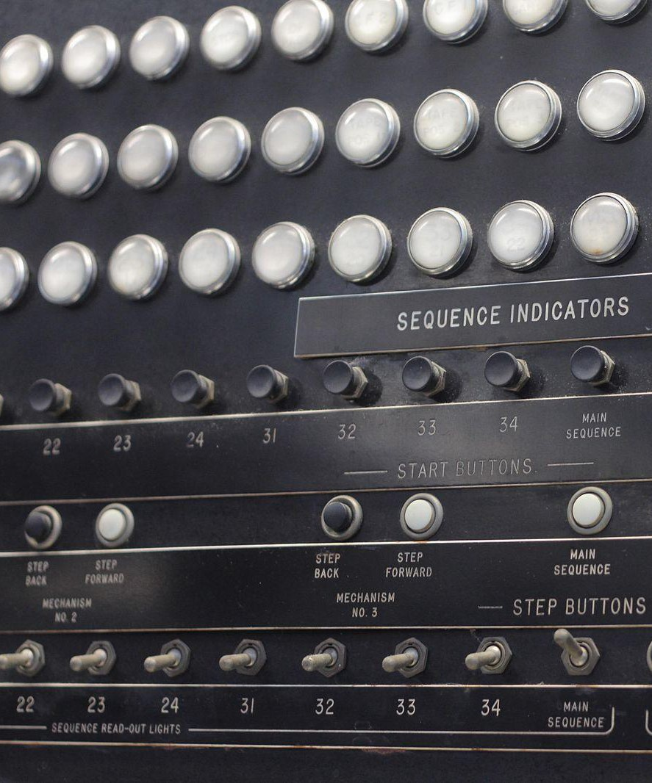
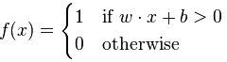
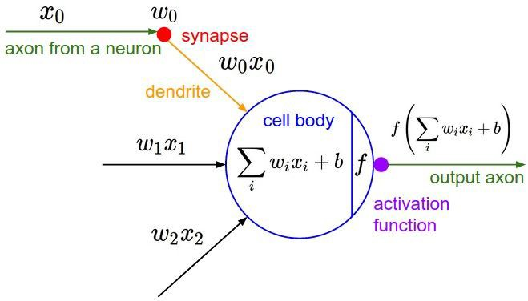
A bit of history...
The Mark I Perceptron machine was the first implementation of the perceptron algorithm.
The machine was connected to a camera that used 20×20 cadmium sulfide photocells to produce a 400-pixel image.
recognized
letters of the alphabet
update rule:
Frank Rosenblatt, ~1957: Perceptron
This image by Rocky Acosta is licensed under CC-BY 3.0
Lecture 5 -
5
Fei-Fei Li & Justin Johnson & Serena Yeung Lecture 5 - April 18, 2017

Slide 6
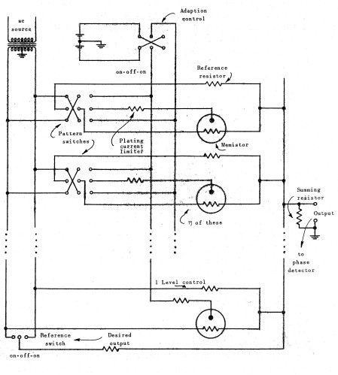
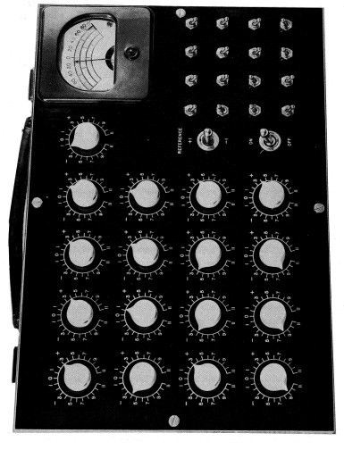
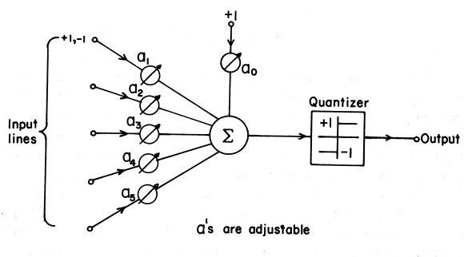
A bit of history...
Widrow and Hoff, ~1960: Adaline/Madaline
These figures are reproduced from Widrow 1960, Stanford Electronics Laboratories Technical Report with permission from Stanford University Special Collections.
Lecture 5 -
5
Fei-Fei Li & Justin Johnson & Serena Yeung Lecture 5 - April 18, 2017

Slide 7
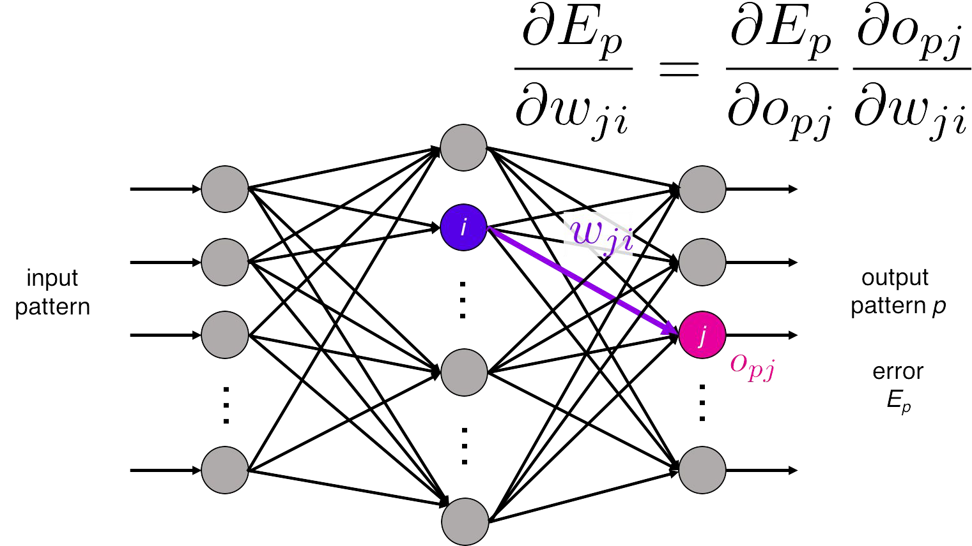
A bit of history...
recognizable math
Illustration of Rumelhart et al., 1986 by Lane McIntosh, copyright CS231n 2017
Rumelhart et al., 1986: First time back-propagation became popular
Lecture 5 -
5
Fei-Fei Li & Justin Johnson & Serena Yeung Lecture 5 - April 18, 2017

Slide 8
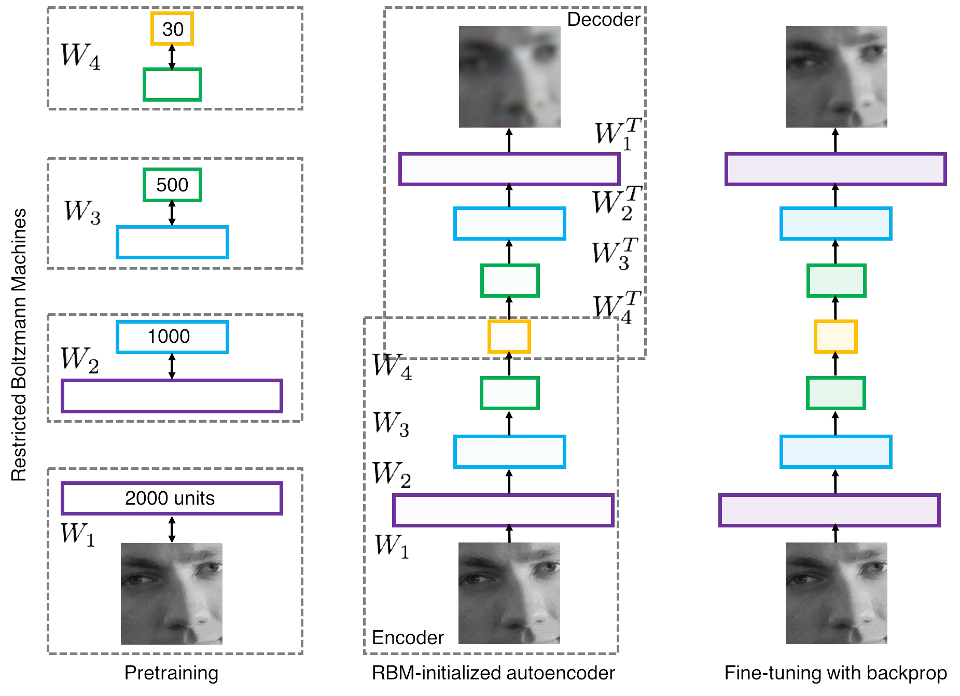
A bit of history...
[Hinton and Salakhutdinov 2006]
Reinvigorated research in Deep Learning
Illustration of Hinton and Salakhutdinov 2006 by Lane McIntosh, copyright CS231n 2017
Lecture 5 -
5
Fei-Fei Li & Justin Johnson & Serena Yeung Lecture 5 - April 18, 2017

Slide 9
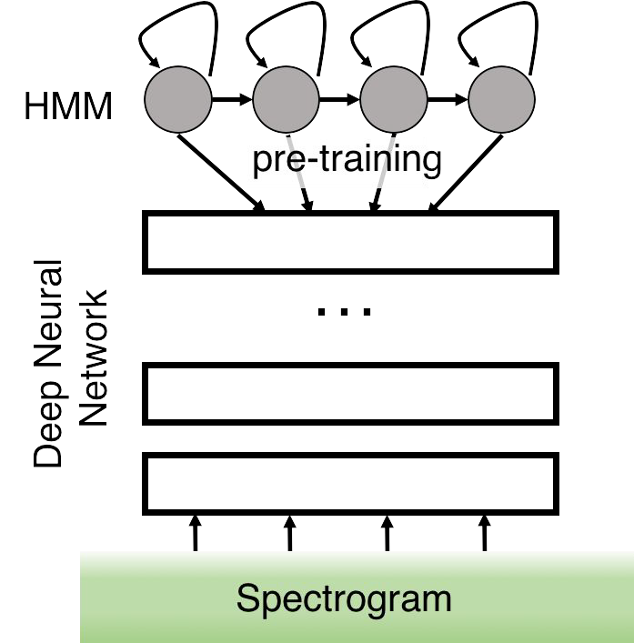
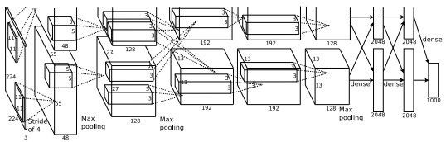
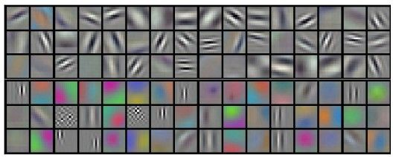
First strong results
Acoustic Modeling using Deep Belief Networks
Abdel-rahman Mohamed, George Dahl, Geoffrey Hinton, 2010
Context-Dependent Pre-trained Deep Neural Networks for Large Vocabulary Speech Recognition
George Dahl, Dong Yu, Li Deng, Alex Acero, 2012
Imagenet classification with deep convolutional neural networks
Alex Krizhevsky, Ilya Sutskever, Geoffrey E Hinton, 2012
Illustration of Dahl et al. 2012 by Lane McIntosh, copyright CS231n 2017
Figures copyright Alex Krizhevsky, Ilya Sutskever, and Geoffrey Hinton, 2012. Reproduced with permission.
Lecture 5 -
5
Fei-Fei Li & Justin Johnson & Serena Yeung Lecture 5 - April 18, 2017

Slide 10
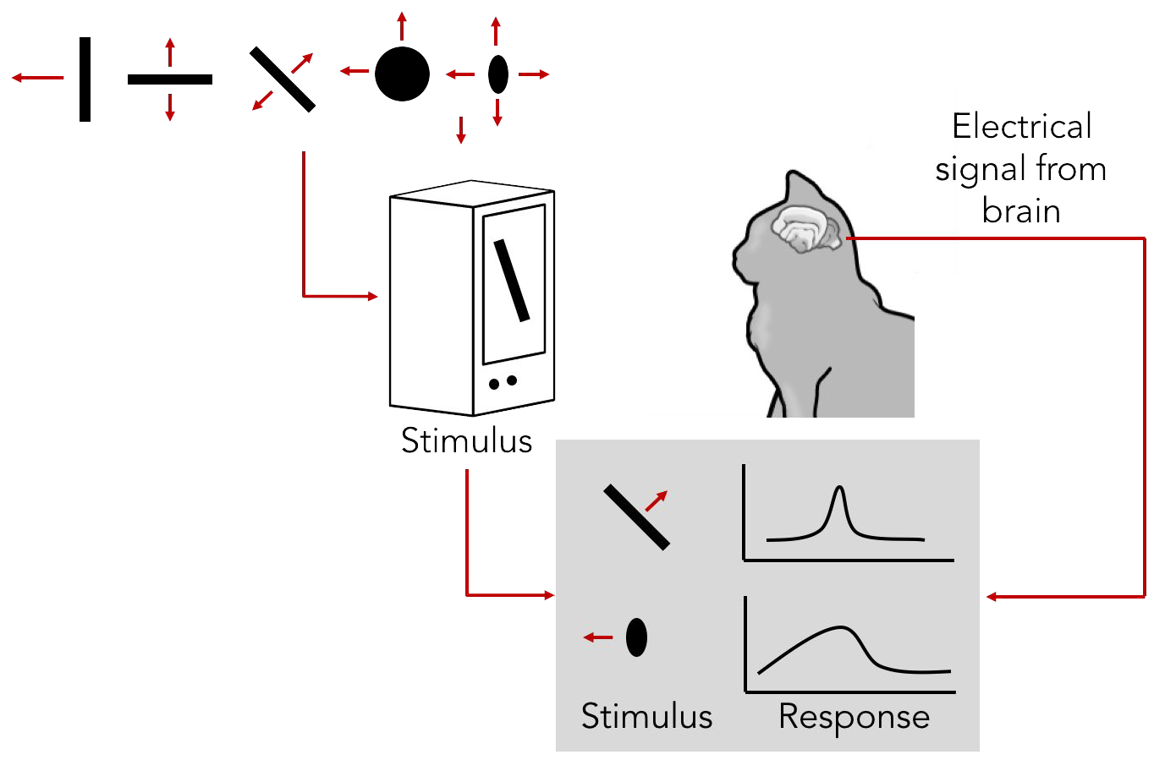
A bit of history:
Hubel & Wiesel, 1959
RECEPTIVE FIELDS OF SINGLE NEURONES IN
THE CAT'S STRIATE CORTEX
1962
RECEPTIVE FIELDS, BINOCULAR INTERACTION
AND FUNCTIONAL ARCHITECTURE IN THE CAT'S VISUAL CORTEX
1968...
Cat image by CNX OpenStax is licensed under CC BY 4.0; changes made
Lecture 5 -
1100

Slide 11
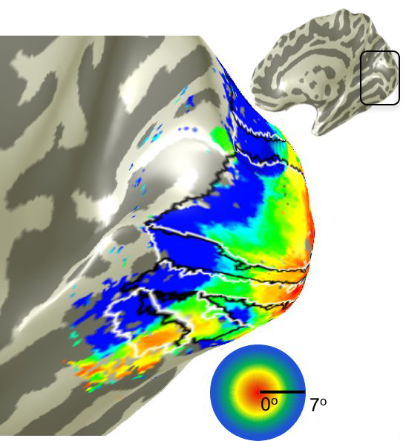
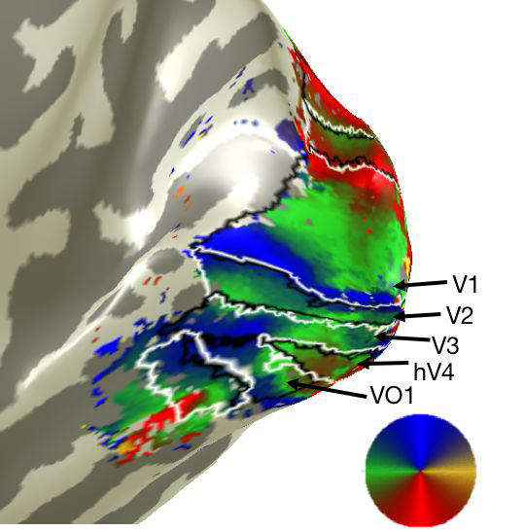
A bit of history
Human brain
Topographical mapping in the cortex:
nearby cells in cortex represent nearby regions in the visual field
Visual cortex
Retinotopy images courtesy of Jesse Gomez in the Stanford Vision & Perception Neuroscience Lab.
Lecture 5 -
1111

Slide 12
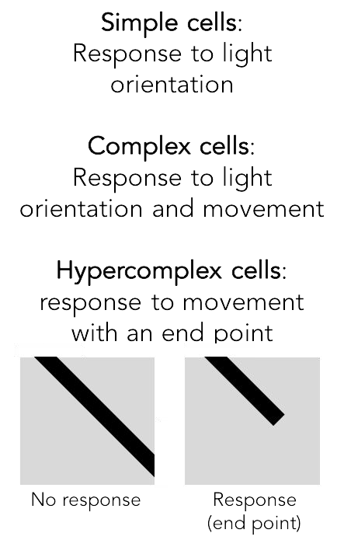
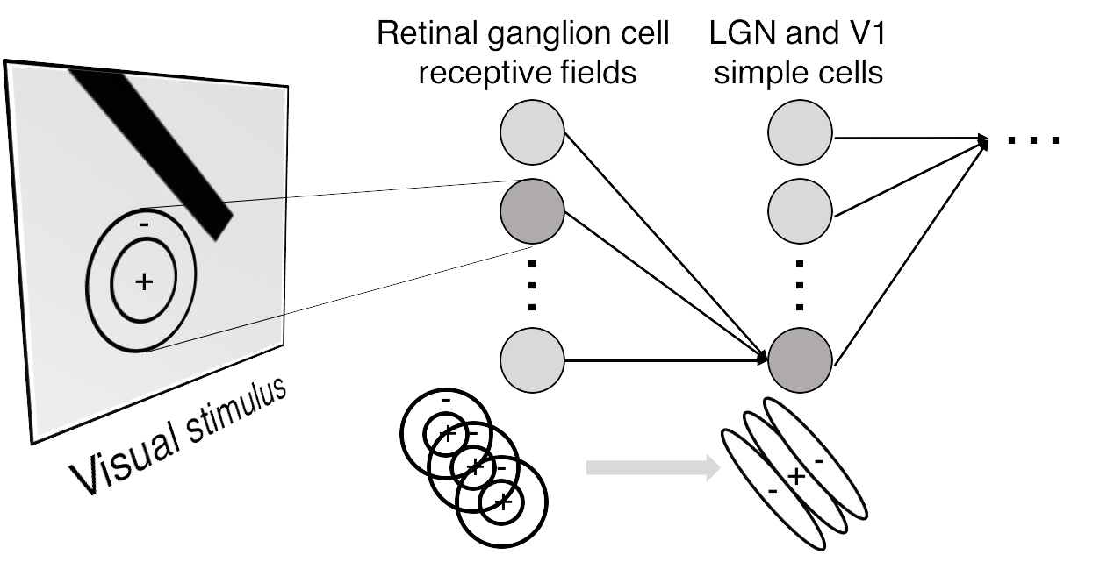
Hierarchical organization
Illustration of hierarchical organization in early visual pathways by Lane McIntosh, copyright CS231n 2017
Lecture 5 -
1122

Slide 13
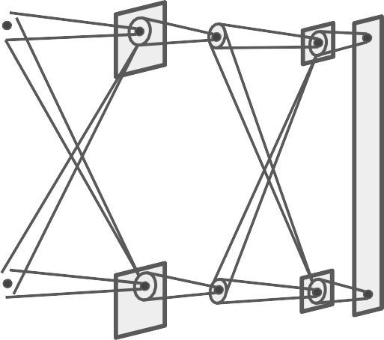
A bit of history:
Neurocognitron
[Fukushima 1980]
“sandwich” architecture (SCSCSC…) simple cells: modifiable parameters complex cells: perform pooling
Lecture 5 -
1133

Slide 14
A bit of history:
Gradient-based learning applied to document recognition
[LeCun, Bottou, Bengio, Haffner 1998]
LeNet-5
Lecture 5 -
1144

Slide 15

A bit of history:
ImageNet Classification with Deep Convolutional Neural Networks [Krizhevsky, Sutskever, Hinton, 2012]
Figure copyright Alex Krizhevsky, Ilya Sutskever, and Geoffrey Hinton, 2012. Reproduced with permission.
“AlexNet”
Lecture 5 -
1155

Slide 16
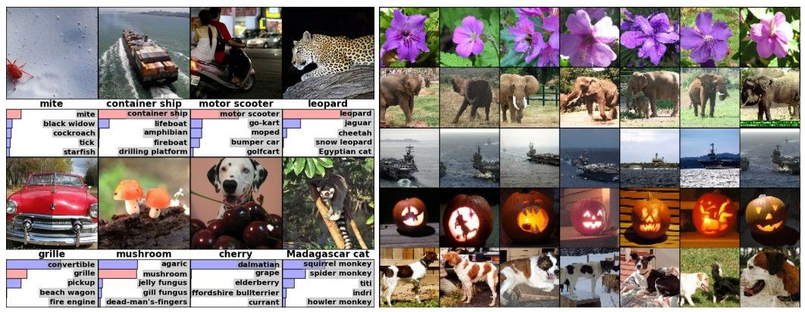
Fast-forward to today: ConvNets are everywhere
Classification Retrieval
Figures copyright Alex Krizhevsky, Ilya Sutskever, and Geoffrey Hinton, 2012. Reproduced with permission.
Fei-Fei Li & Justin Johnson & Serena Yeung Lecture 5 - April 18, 2017

Slide 17
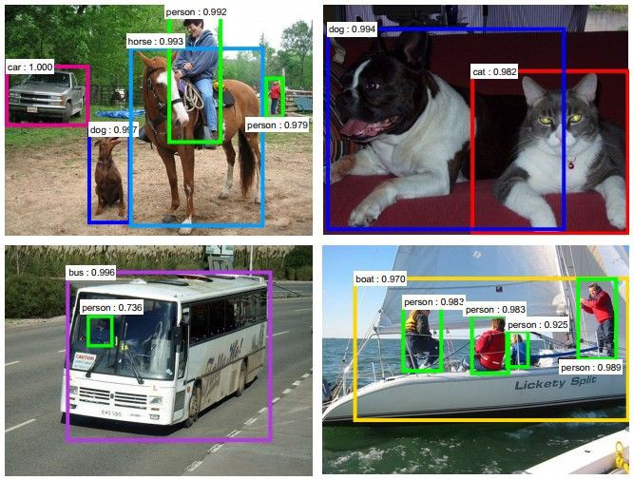
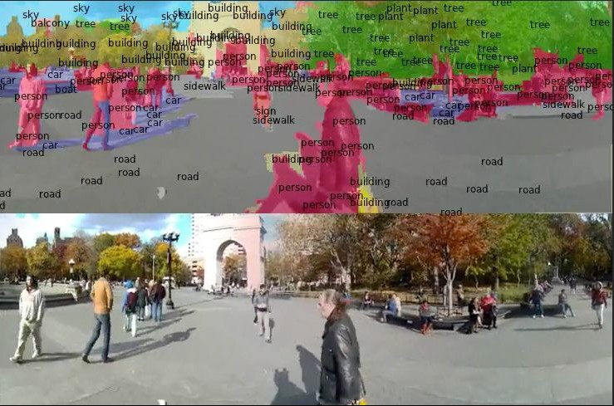
Fast-forward to today: ConvNets are everywhere
Detection Segmentation
Figures copyright Shaoqing Ren, Kaiming He, Ross Girschick, Jian Sun, 2015. Reproduced with permission.
[Faster R-CNN: Ren, He, Girshick, Sun 2015]
Figures copyright Clement Farabet, 2012. Reproduced with permission.
[Farabet et al., 2012]
Fei-Fei Li & Justin Johnson & Serena Yeung Lecture 5 - April 18, 2017

Slide 18
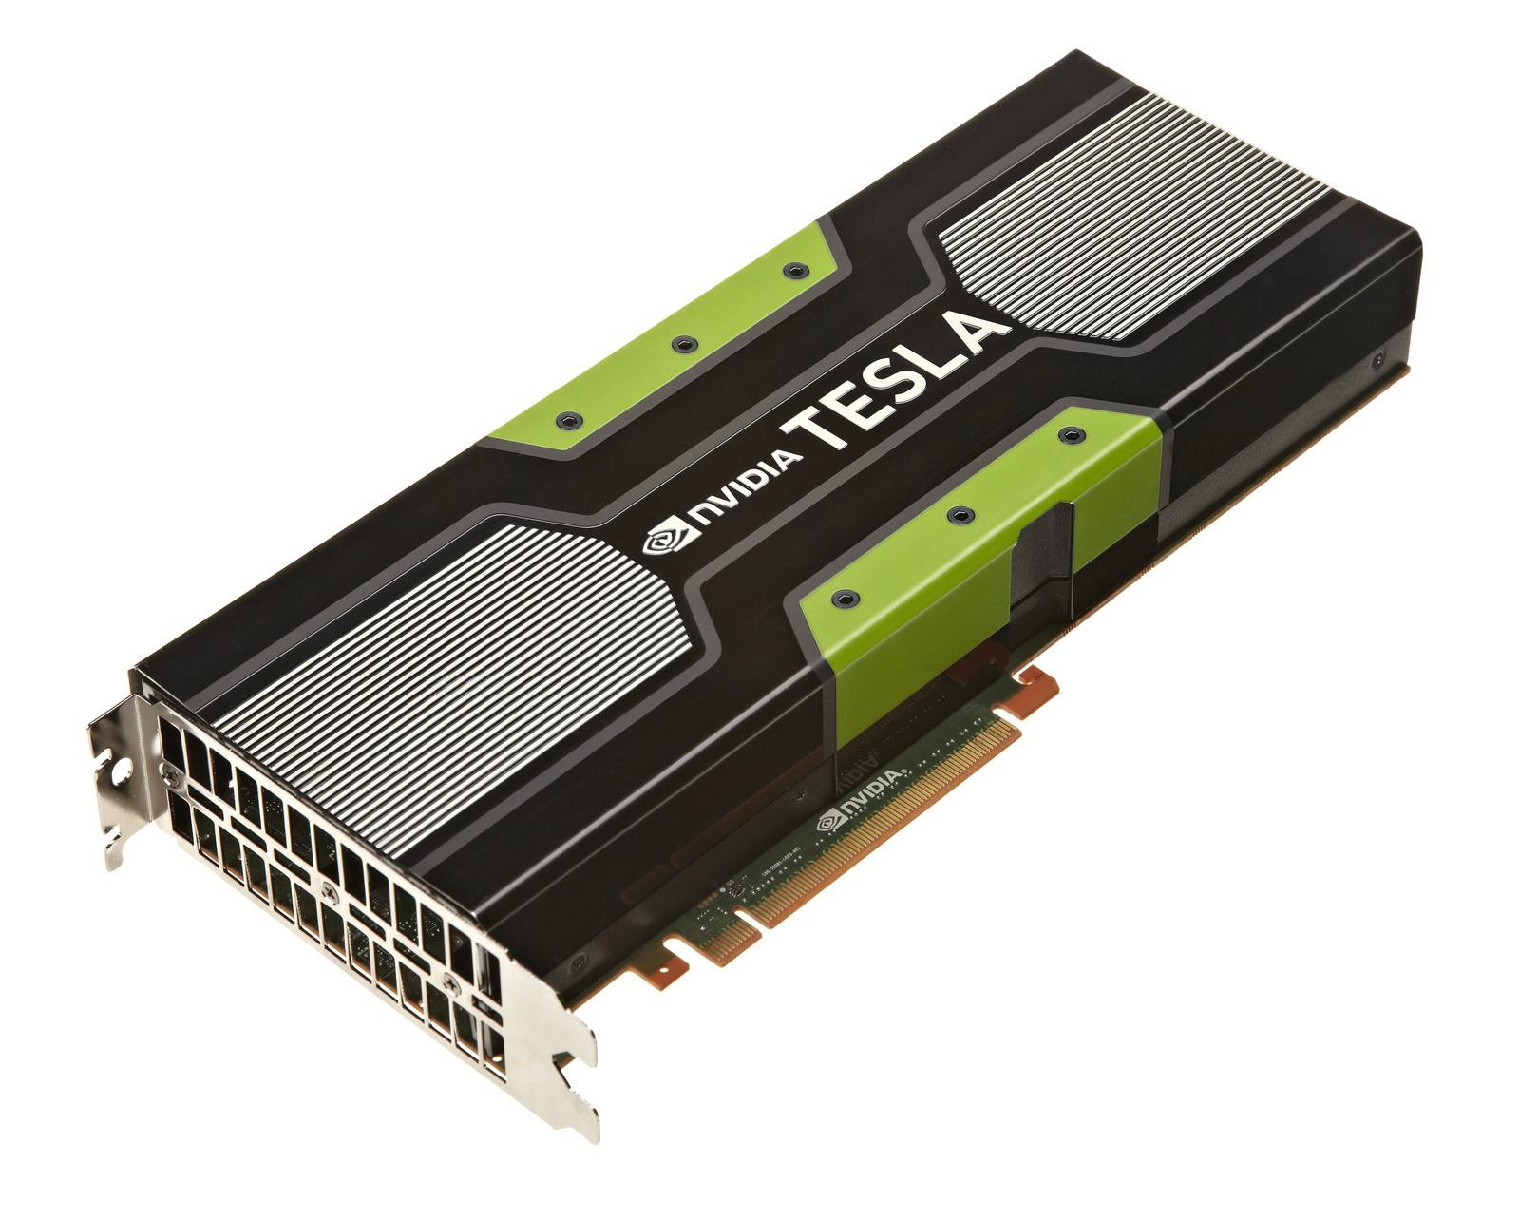
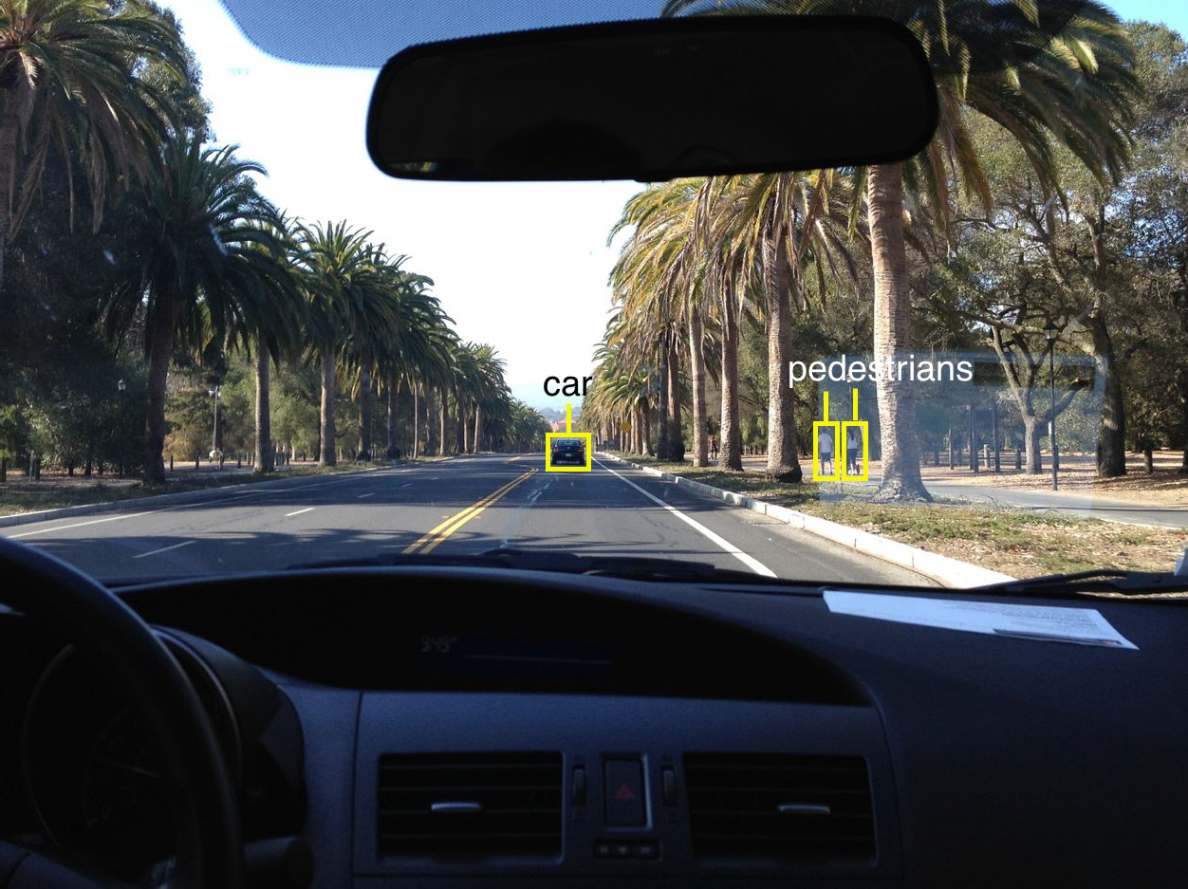
Fast-forward to today: ConvNets are everywhere
This image by GBPublic_PR is licensed under CC-BY 2.0
NVIDIA Tesla line
(these are the GPUs on rye01.stanford.edu)
Note that for embedded systems a typical setup would involve NVIDIA Tegras, with integrated GPU and ARM-based CPU cores.
self-driving cars
Photo by Lane McIntosh. Copyright CS231n 2017.
Fei-Fei Li & Justin Johnson & Serena Yeung Lecture 5 - April 18, 2017

Slide 19
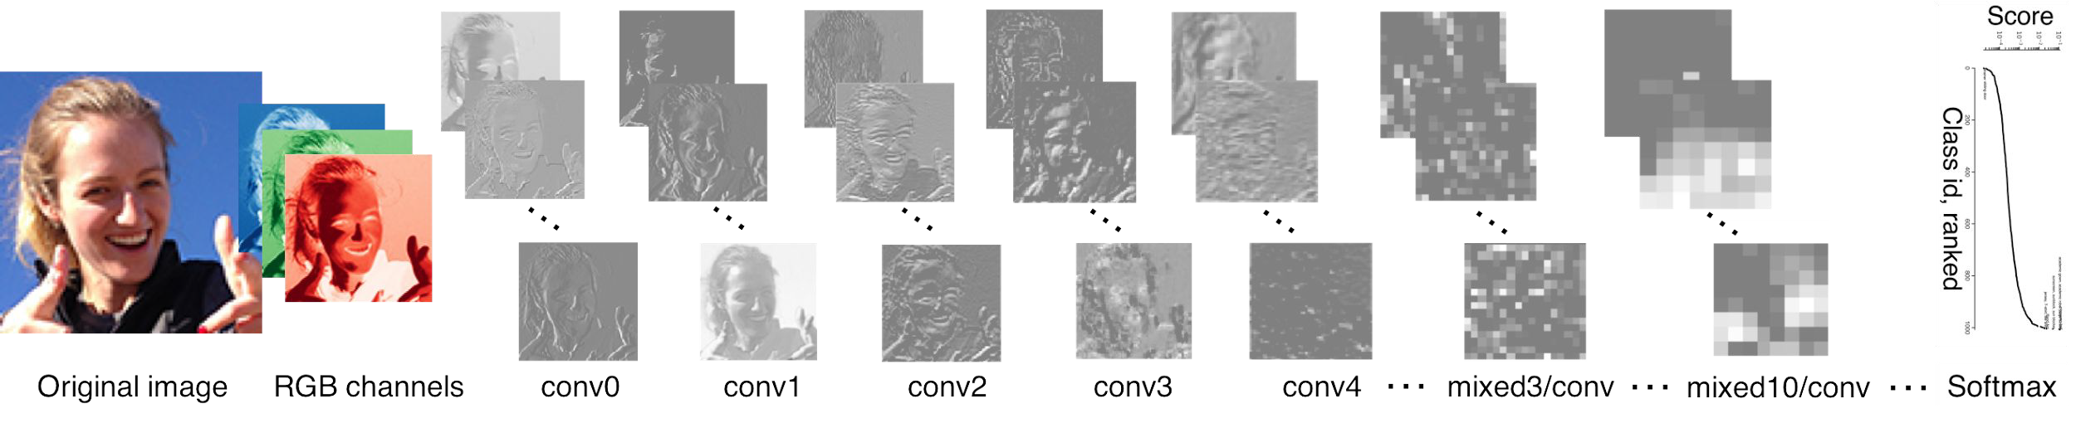
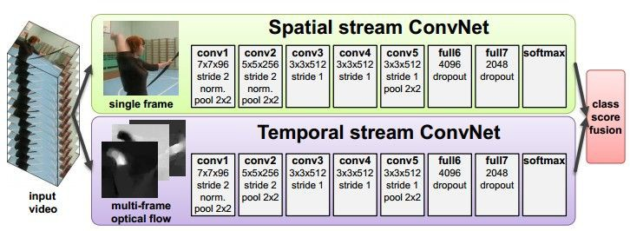
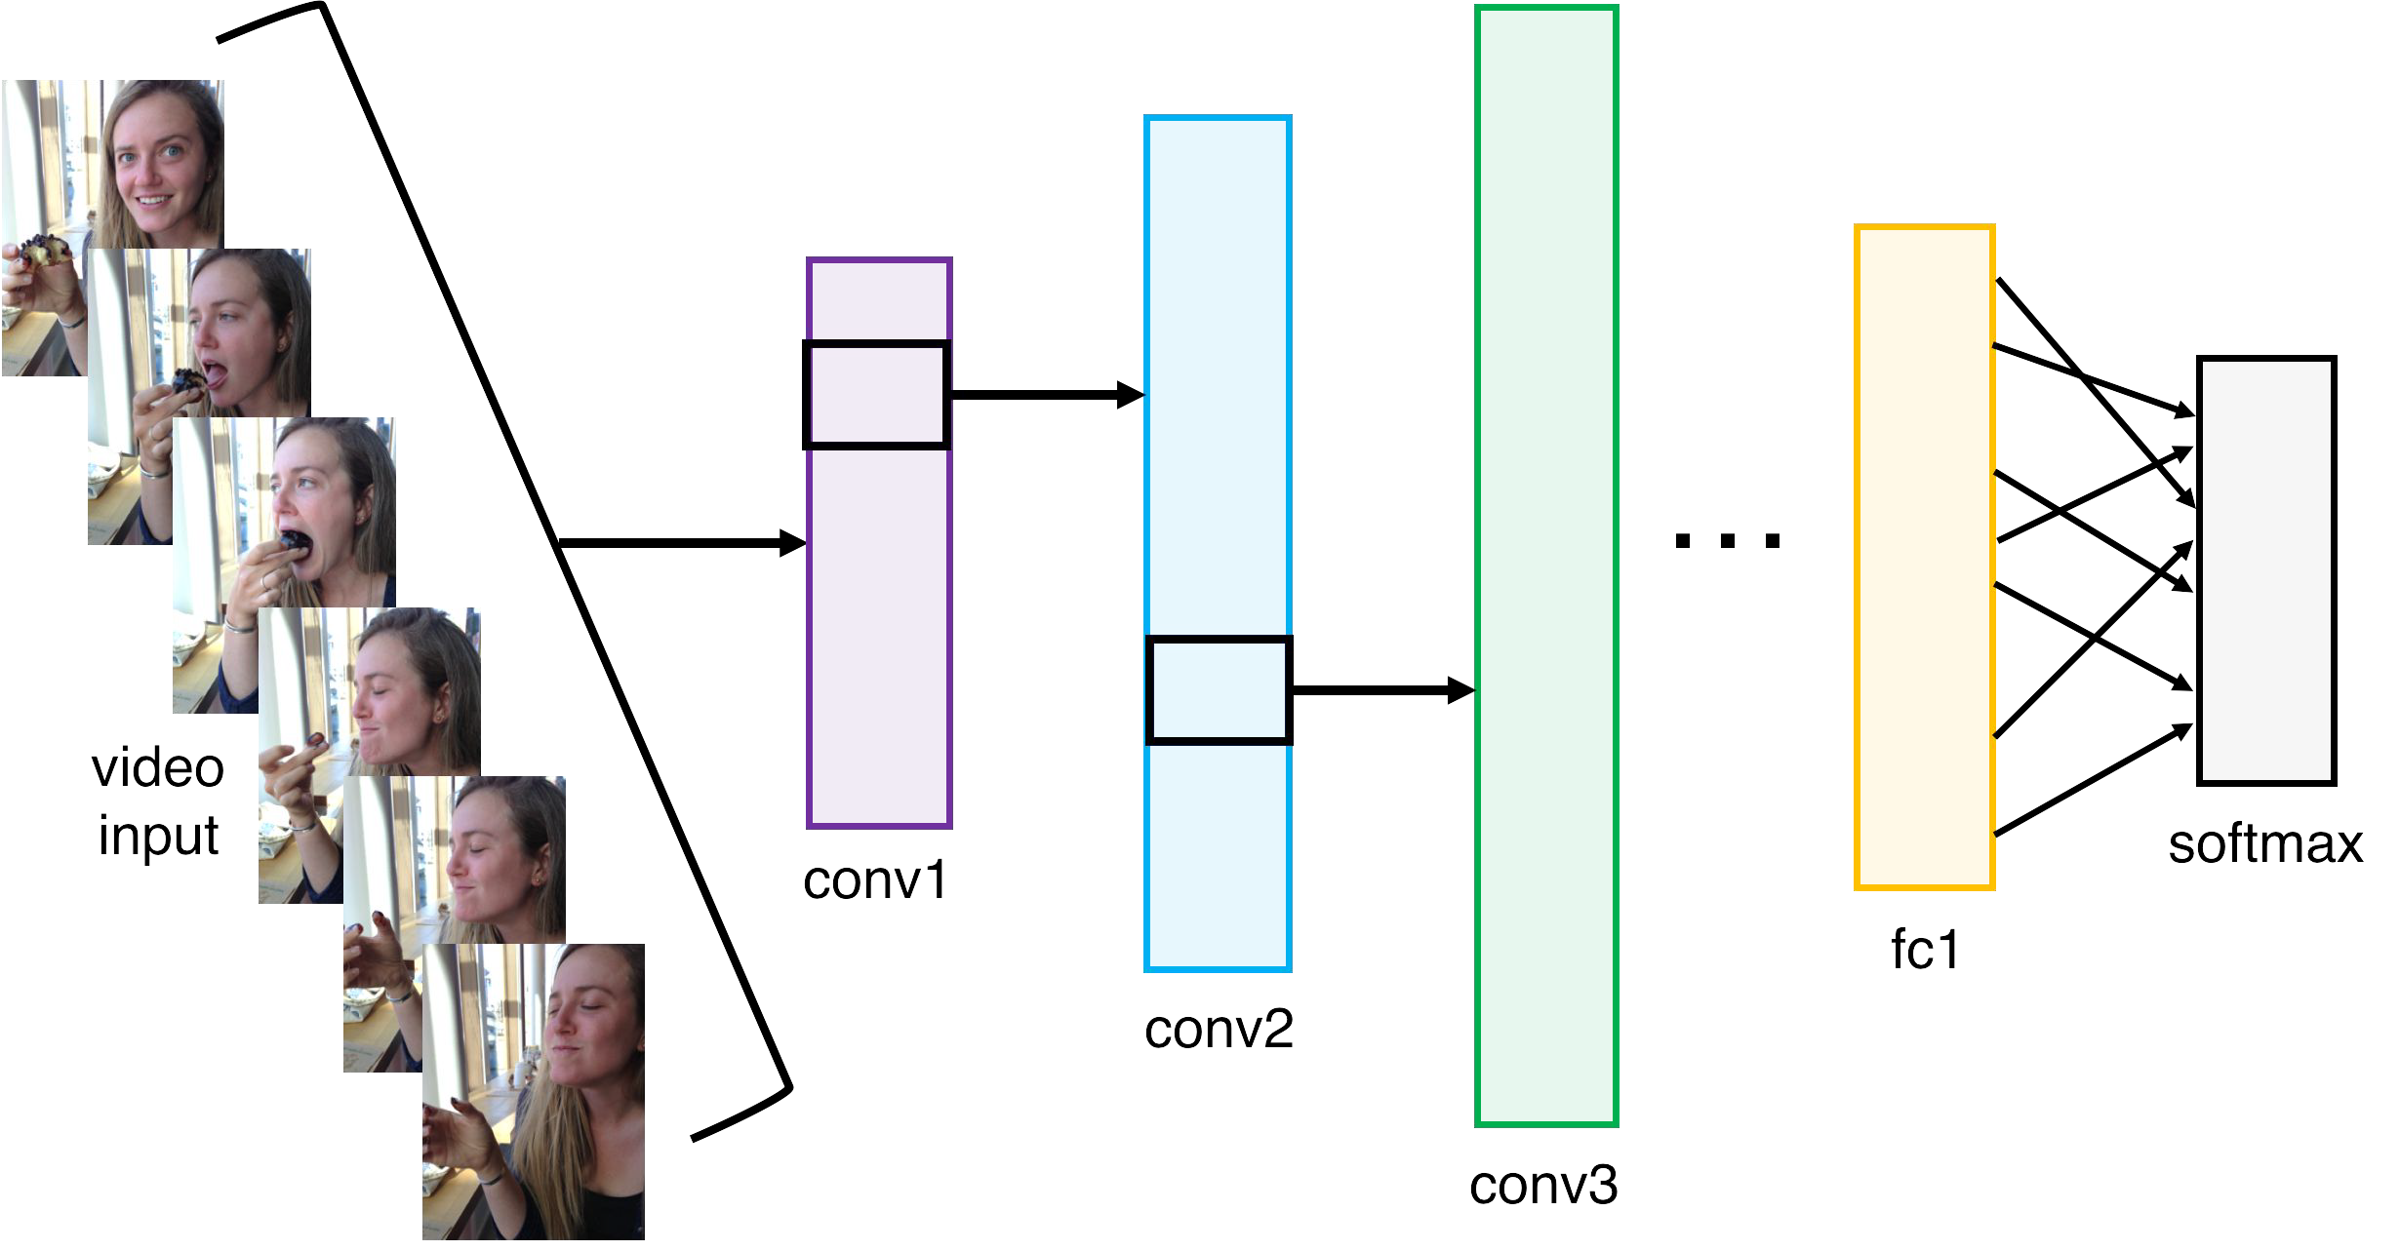
Fast-forward to today: ConvNets are everywhere
[Taigman et al. 2014]
Activations of inception-v3 architecture [Szegedy et al. 2015] to image of Emma McIntosh, used with permission. Figure and architecture not from Taigman et al. 2014.
Figures copyright Simonyan et al., 2014. Reproduced with permission.
Illustration by Lane McIntosh, photos of Katie Cumnock used with permission.
[Simonyan et al. 2014]
Fei-Fei Li & Justin Johnson & Serena Yeung Lecture 5 - April 18, 2017

Slide 20
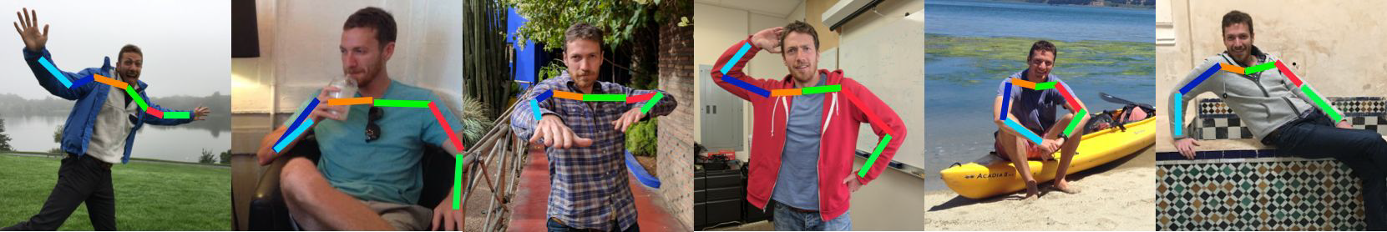
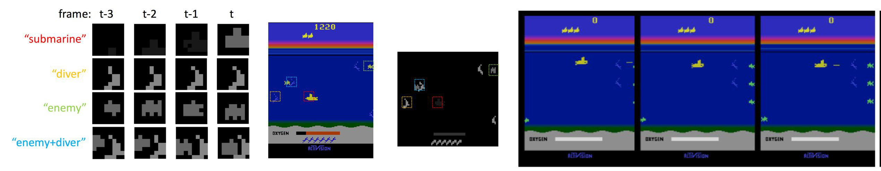
Fast-forward to today: ConvNets are everywhere
Images are examples of pose estimation, not actually from Toshev & Szegedy 2014. Copyright Lane McIntosh.
[Toshev, Szegedy 2014]
[Guo et al. 2014]
Figures copyright Xiaoxiao Guo, Satinder Singh, Honglak Lee, Richard Lewis, and Xiaoshi Wang, 2014. Reproduced with permission.
Fei-Fei Li & Justin Johnson & Serena Yeung Lecture 5 - April 18, 2017

Slide 21
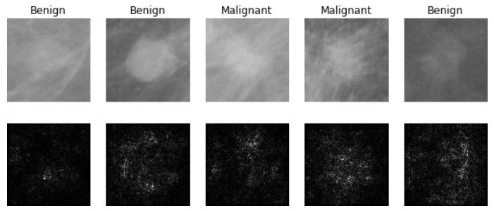
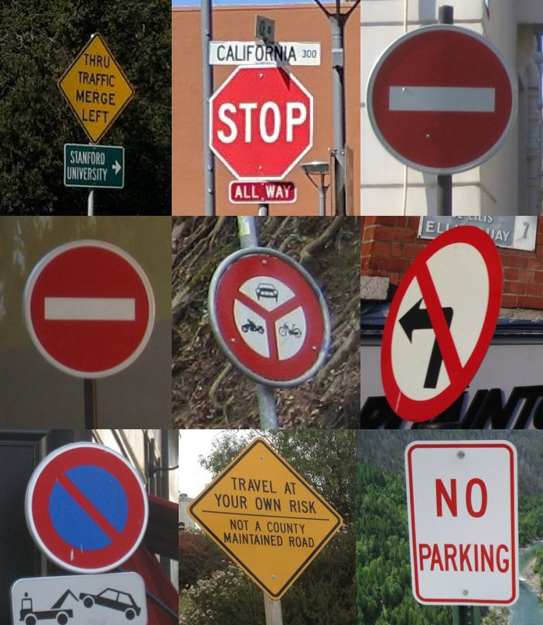
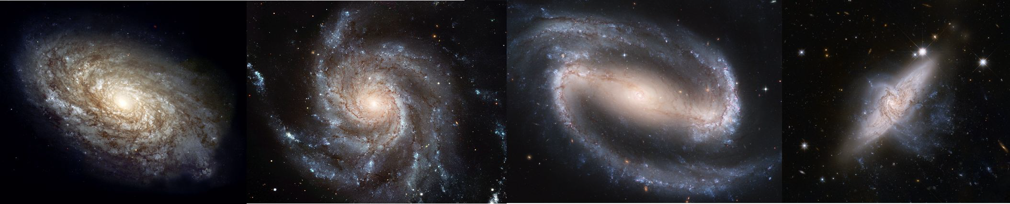
Fast-forward to today: ConvNets are everywhere
[Levy et al. 2016]
Figure copyright Levy et al. 2016. Reproduced with permission.
[Sermanet et al. 2011] [Ciresan et al.]
Photos by Lane McIntosh. Copyright CS231n 2017.
[Dieleman et al. 2014]
From left to right: public domain by NASA, usage permitted by ESA/Hubble, public domain by NASA, and public domain.
Fei-Fei Li & Justin Johnson & Serena Yeung Lecture 5 - April 18, 2017

Slide 22
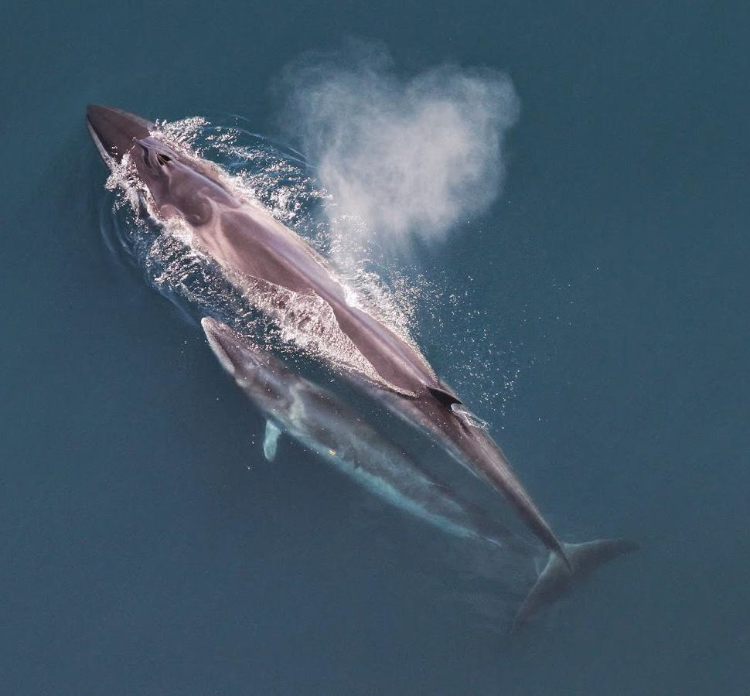
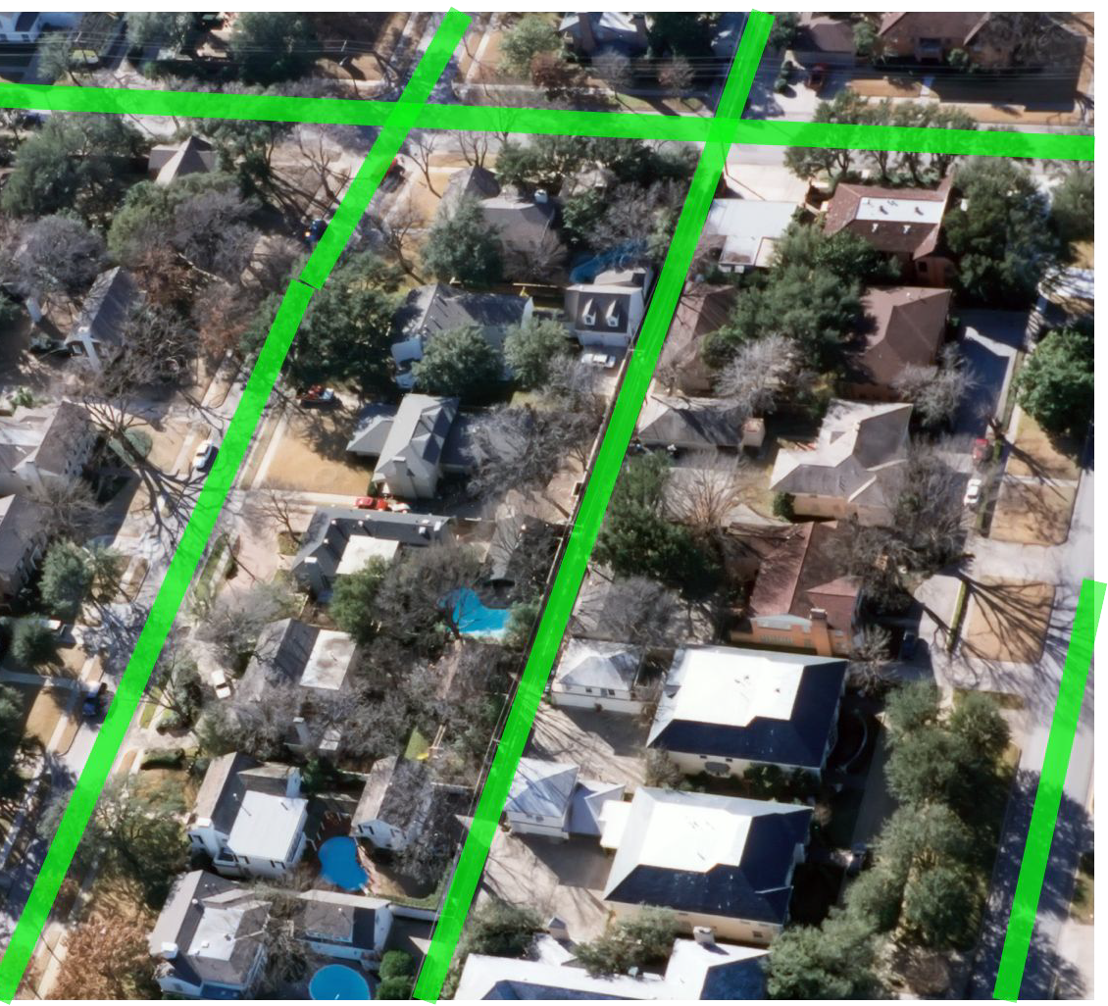
This image by Christin Khan is in the public domain and originally came from the U.S. NOAA.
Photo and figure by Lane McIntosh; not actual example from Mnih and Hinton, 2010 paper.
Whale recognition, Kaggle Challenge
Mnih and Hinton, 2010
Fei-Fei Li & Justin Johnson & Serena Yeung Lecture 5 - April 18, 2017

Slide 23
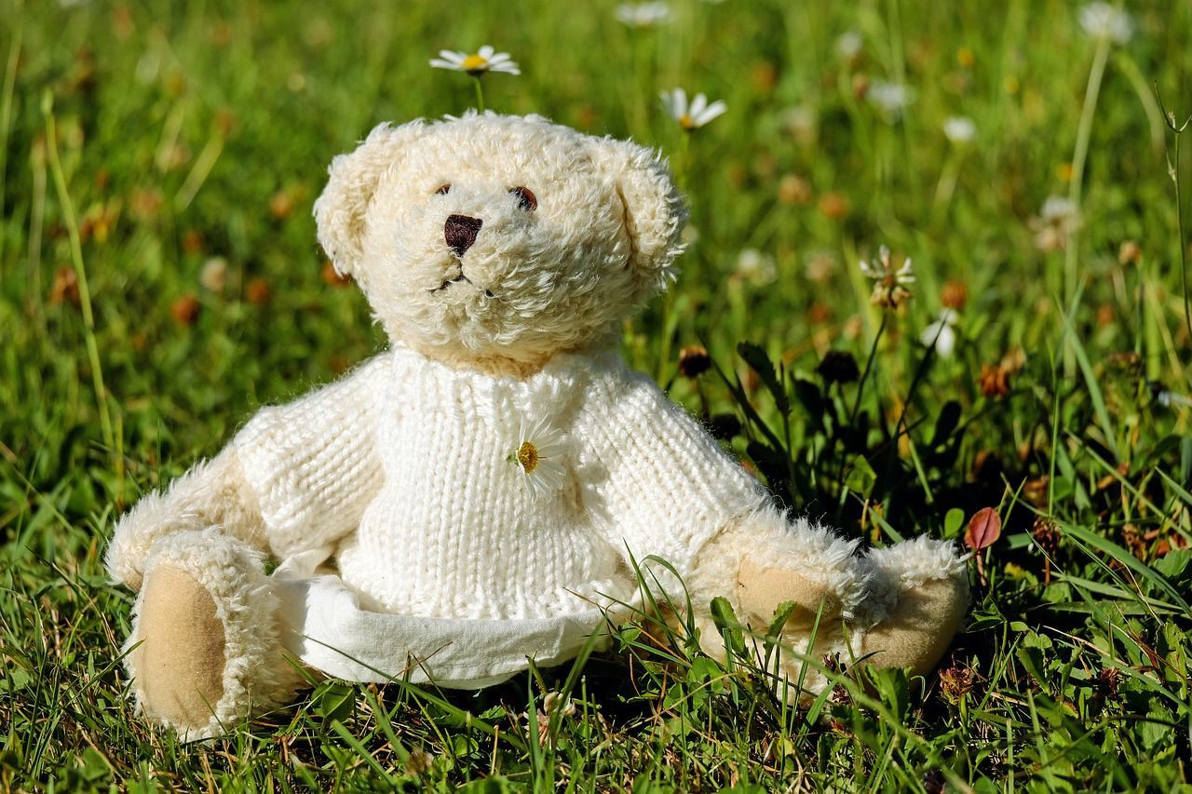
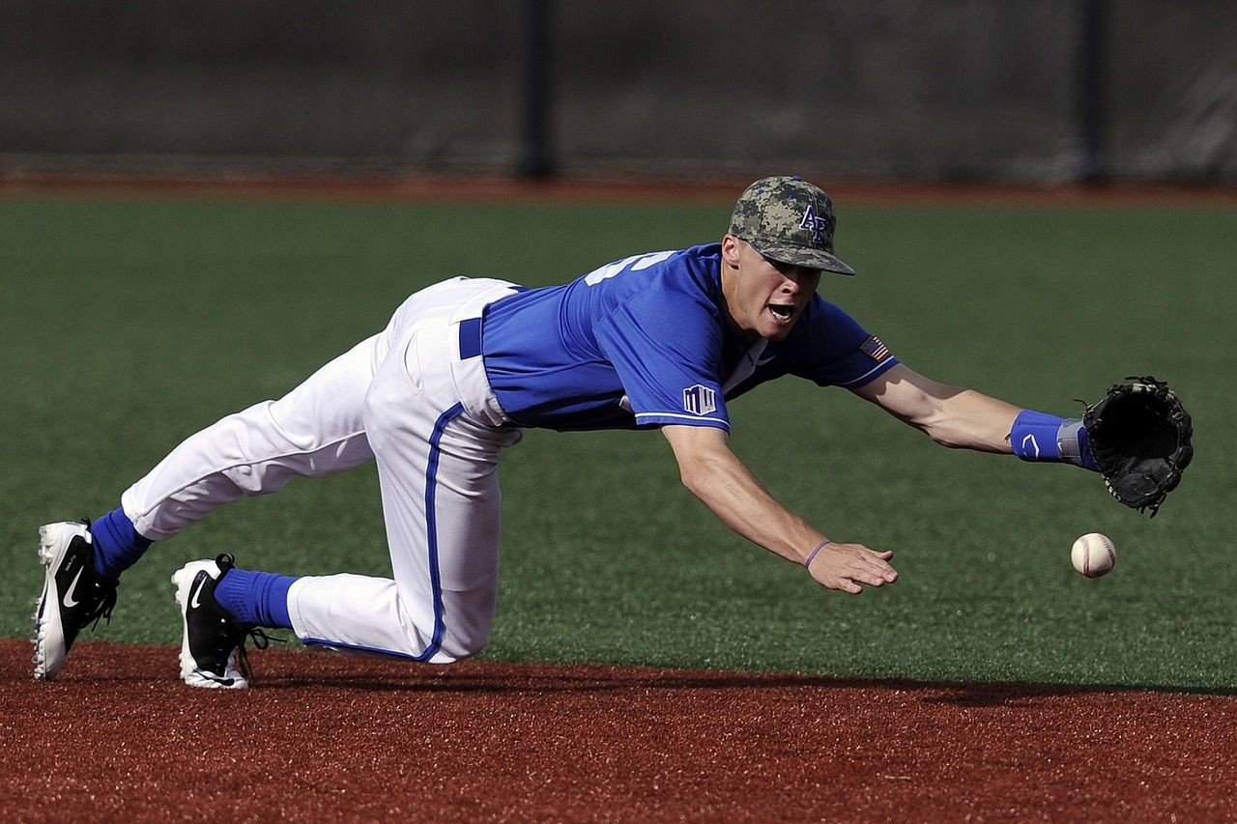

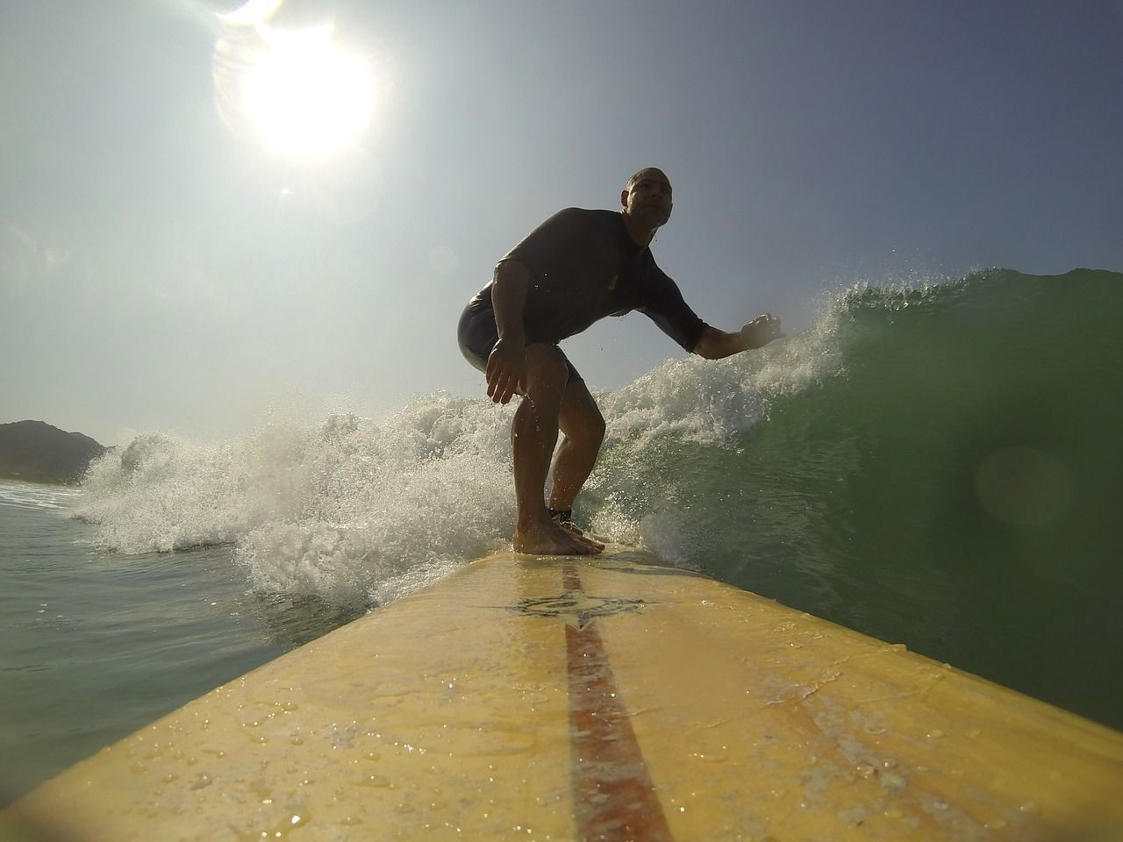


No errors
Minor errors
Somewhat related
Image Captioning
[Vinyals et al., 2015] [Karpathy and Fei-Fei, 2015]
A white teddy bear sitting in the grass
A man in a baseball uniform throwing a ball
A woman is holding a cat in her hand
All images are CC0 Public domain: https://pixabay.com/en/luggage-antique-cat-1643010/
https://pixabay.com/en/teddy-plush-bears-cute-teddy-bear-1623436/ https://pixabay.com/en/surf-wave-summer-sport-litoral-1668716/ https://pixabay.com/en/woman-female-model-portrait-adult-983967/ https://pixabay.com/en/handstand-lake-meditation-496008/ https://pixabay.com/en/baseball-player-shortstop-infield-1045263/
A man riding a wave on top of a surfboard
A cat sitting on a suitcase on the floor
A woman standing on a beach holding a surfboard
Captions generated by Justin Johnson using Neuraltalk2
Fei-Fei Li & Justin Johnson & Serena Yeung Lecture 5 - April 18, 2017

Slide 24
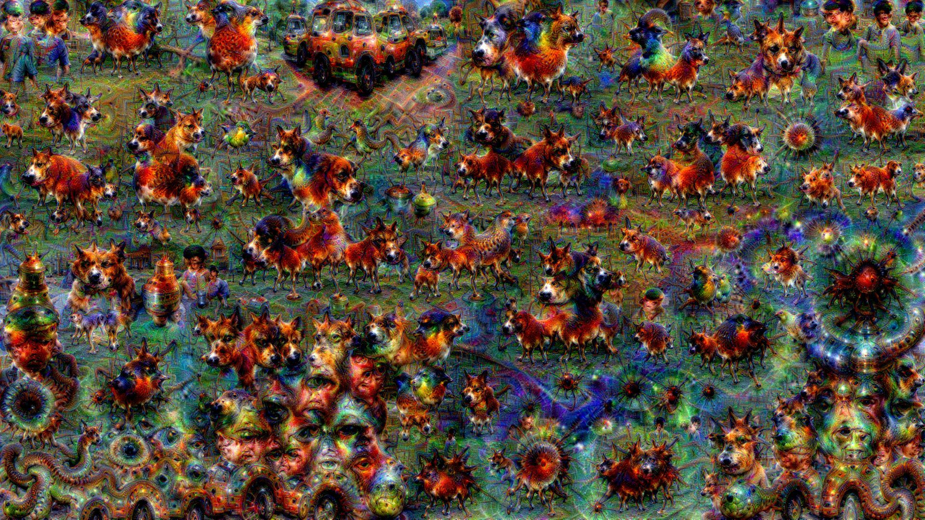
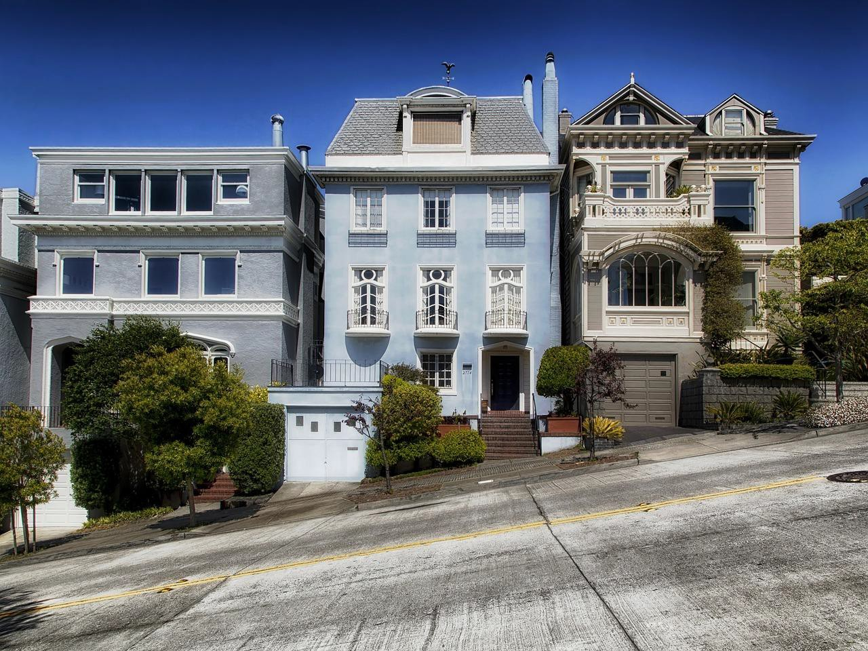
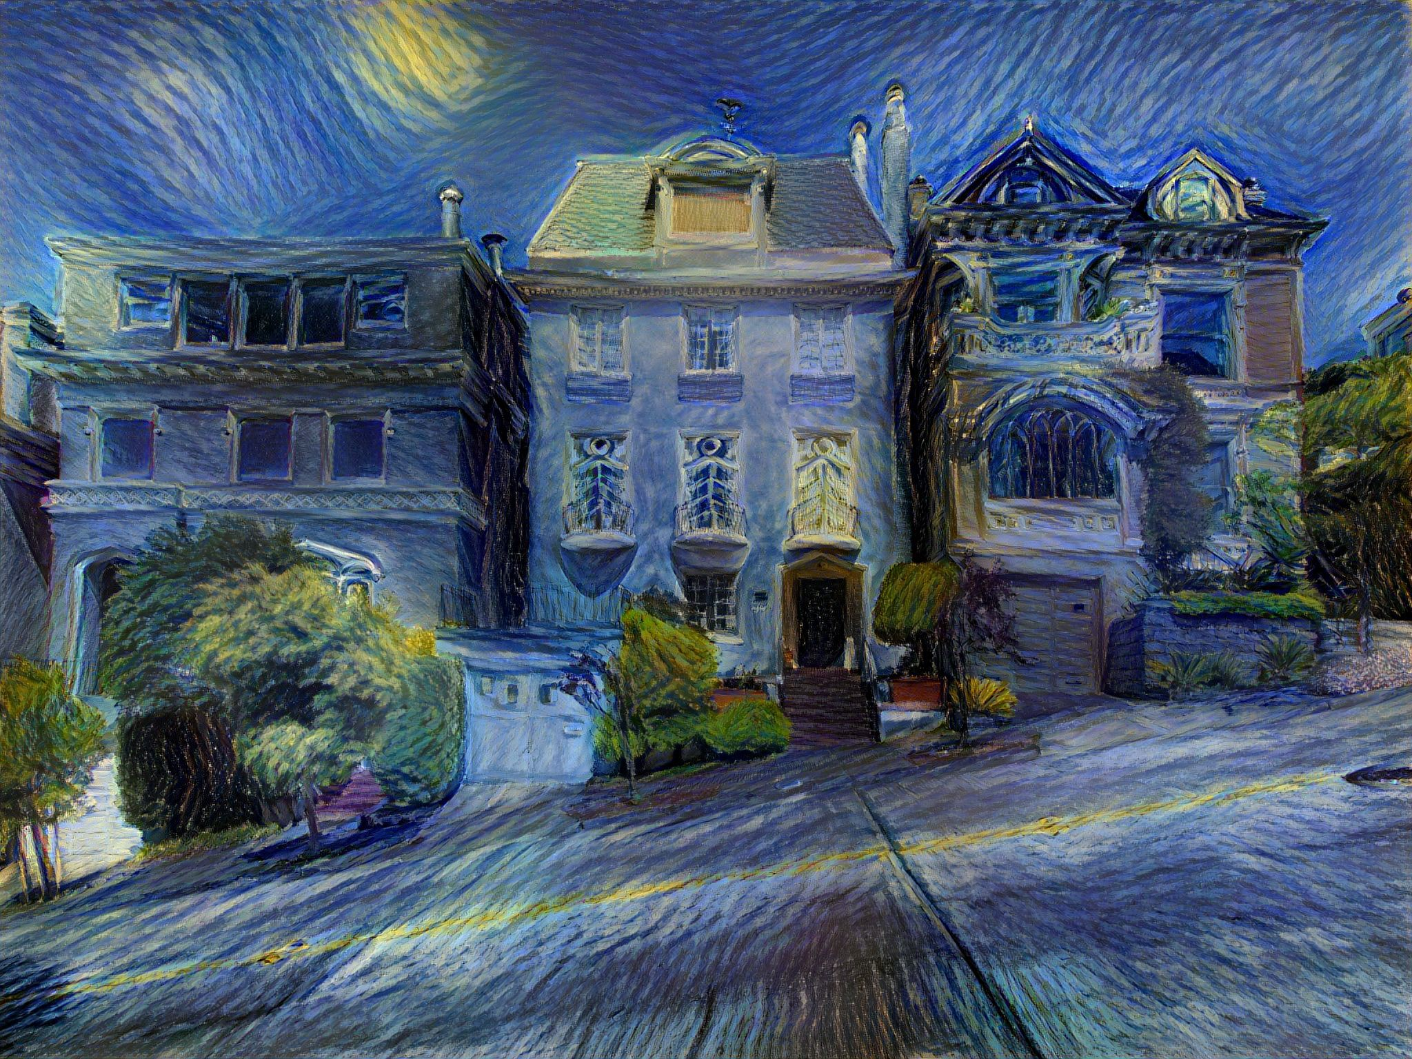

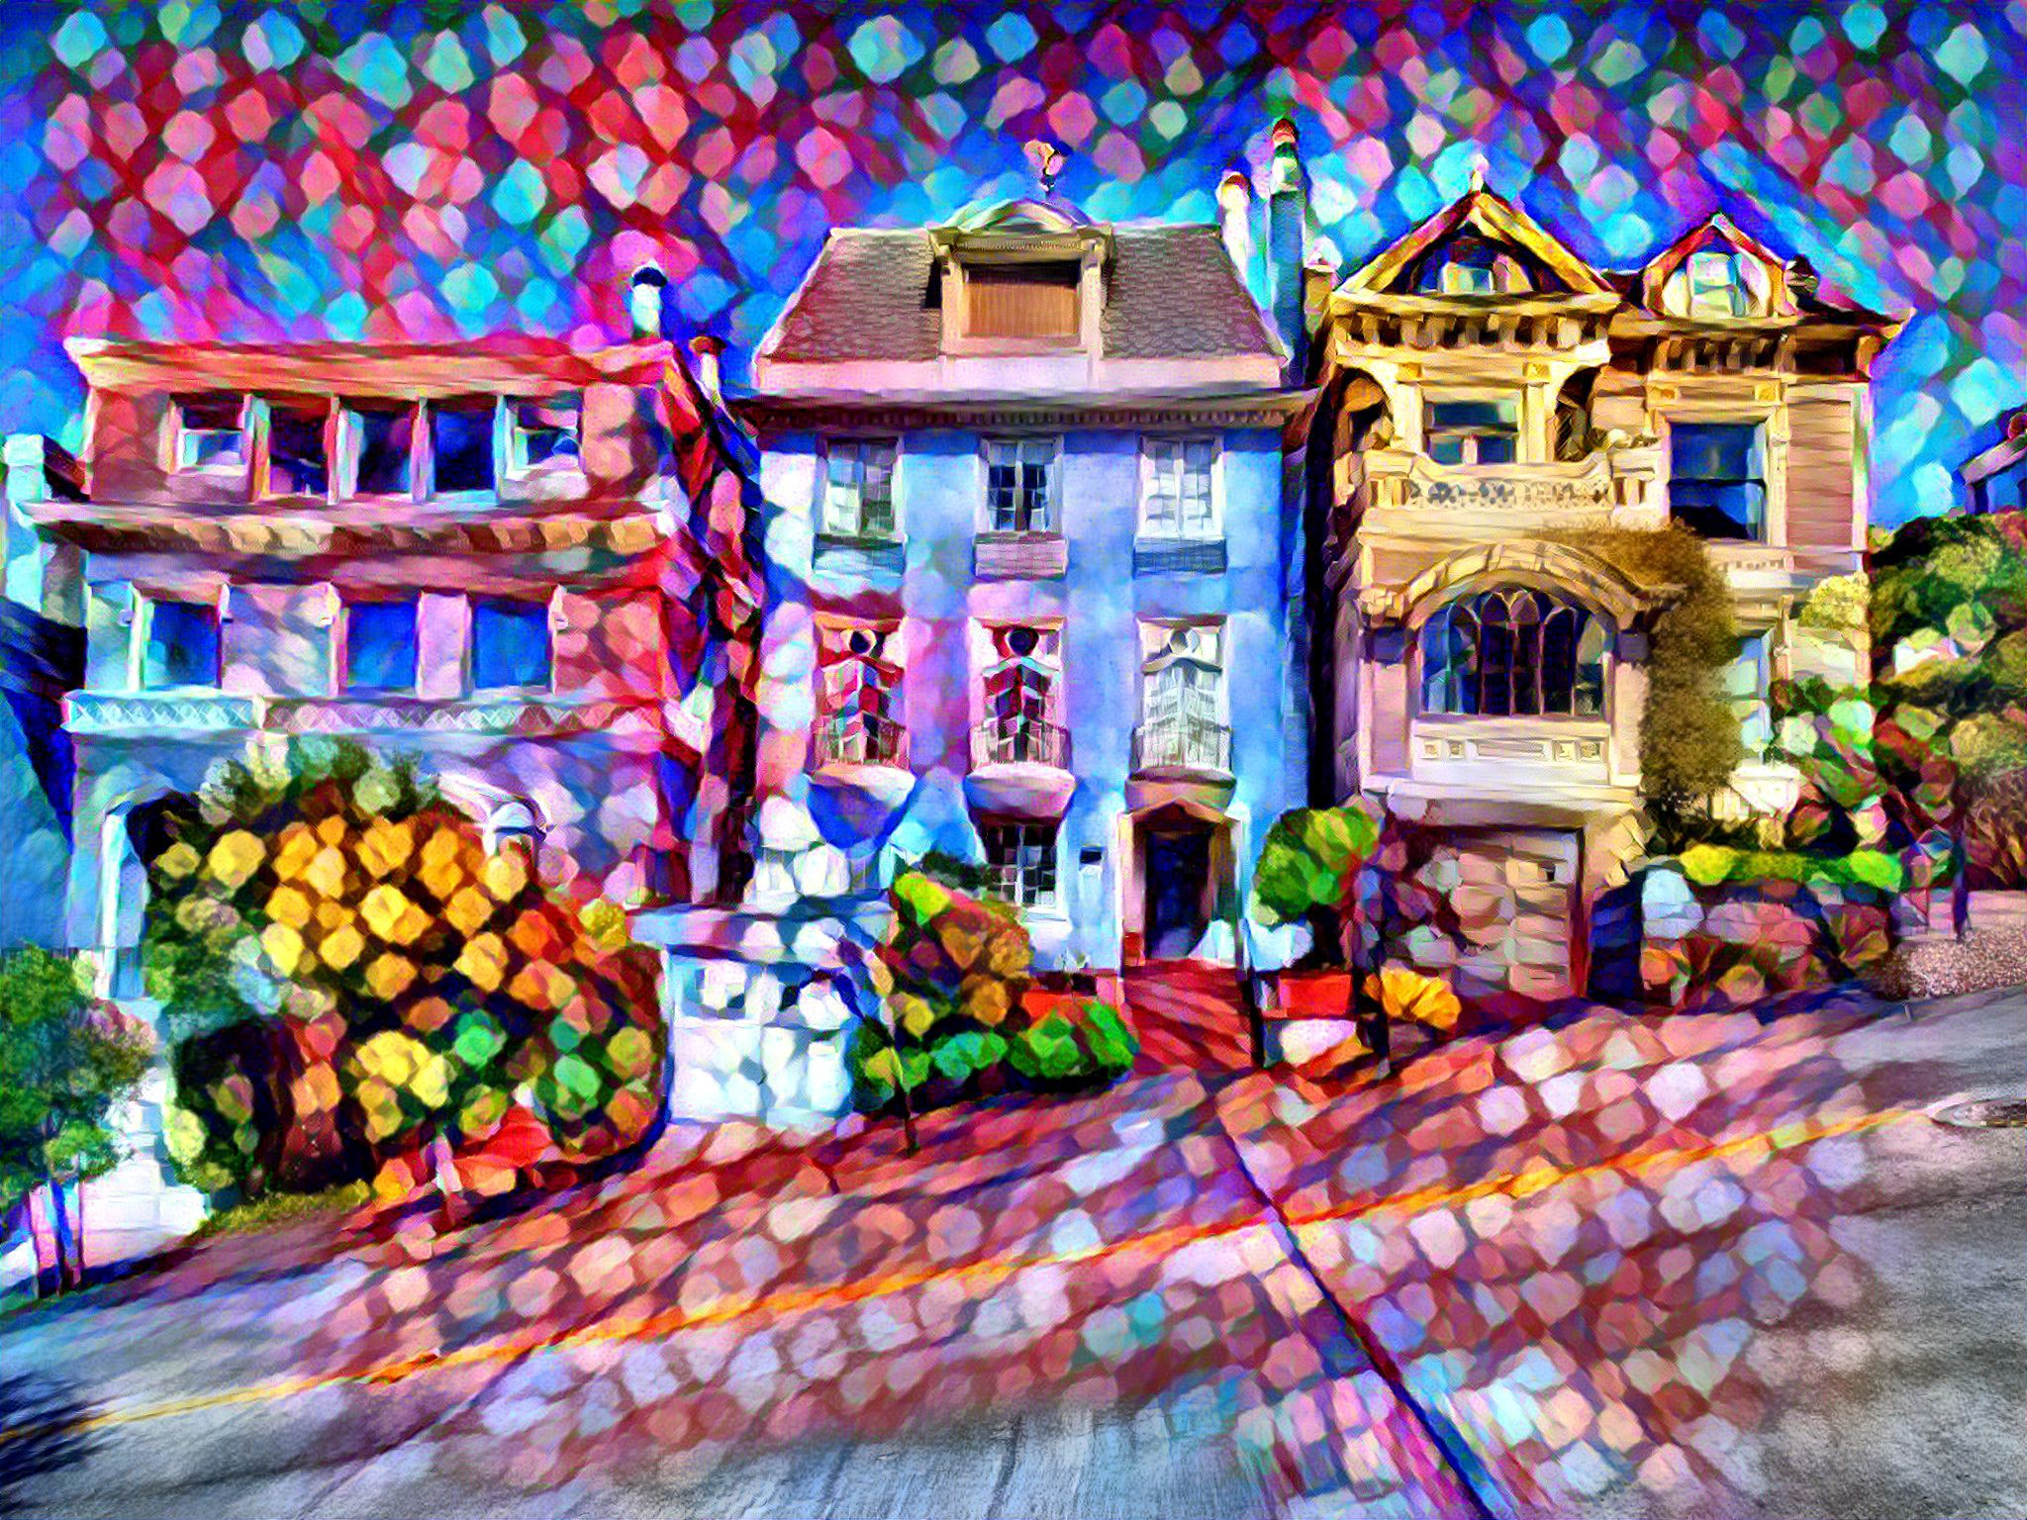
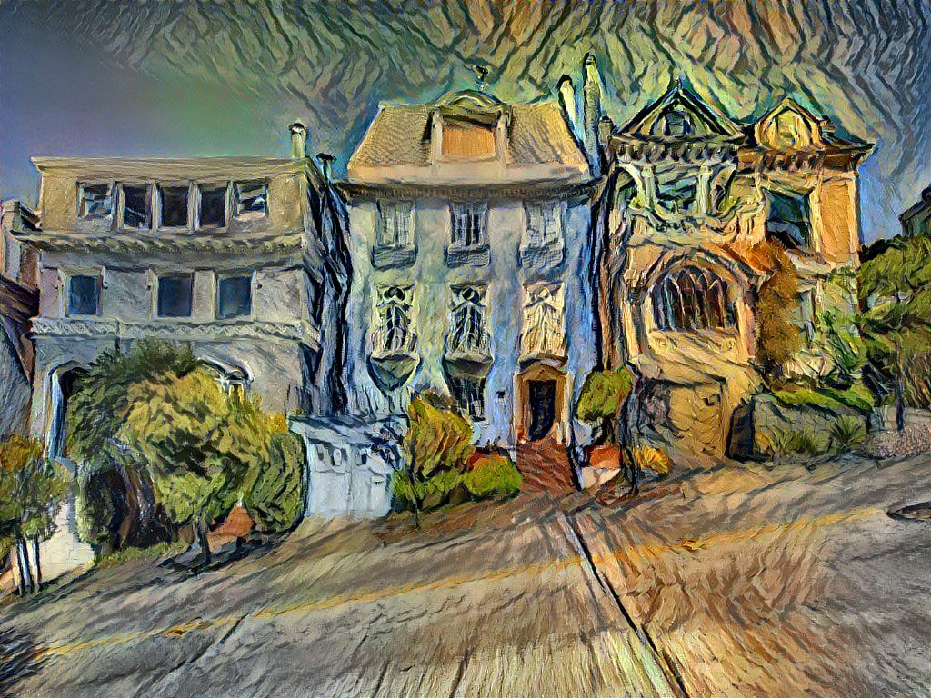
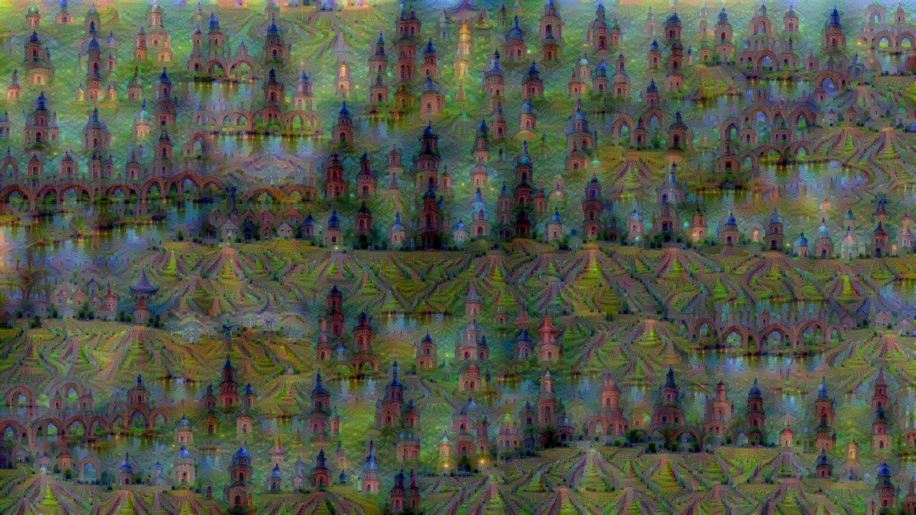
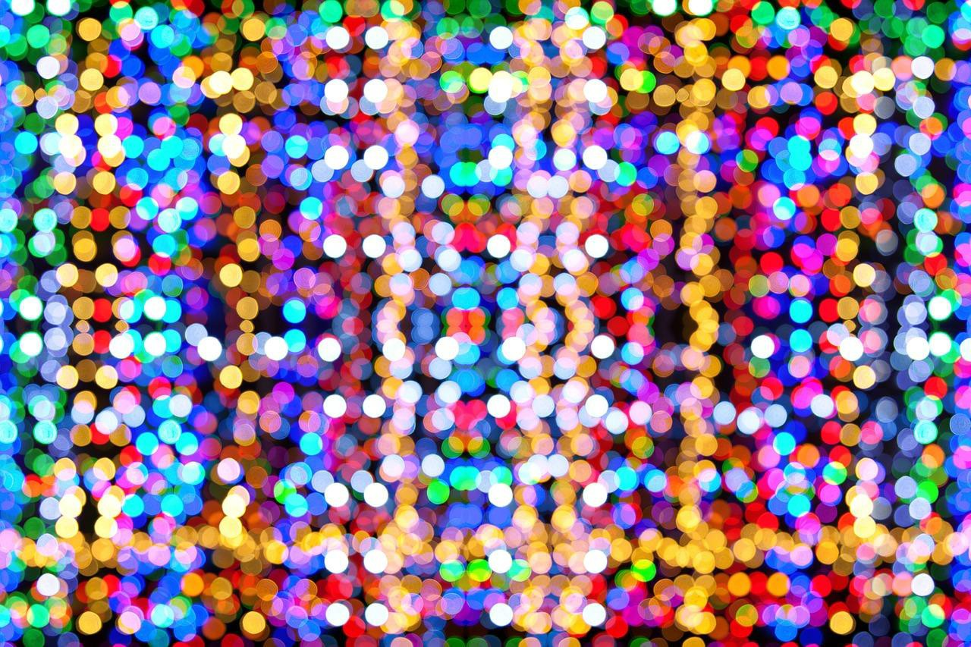
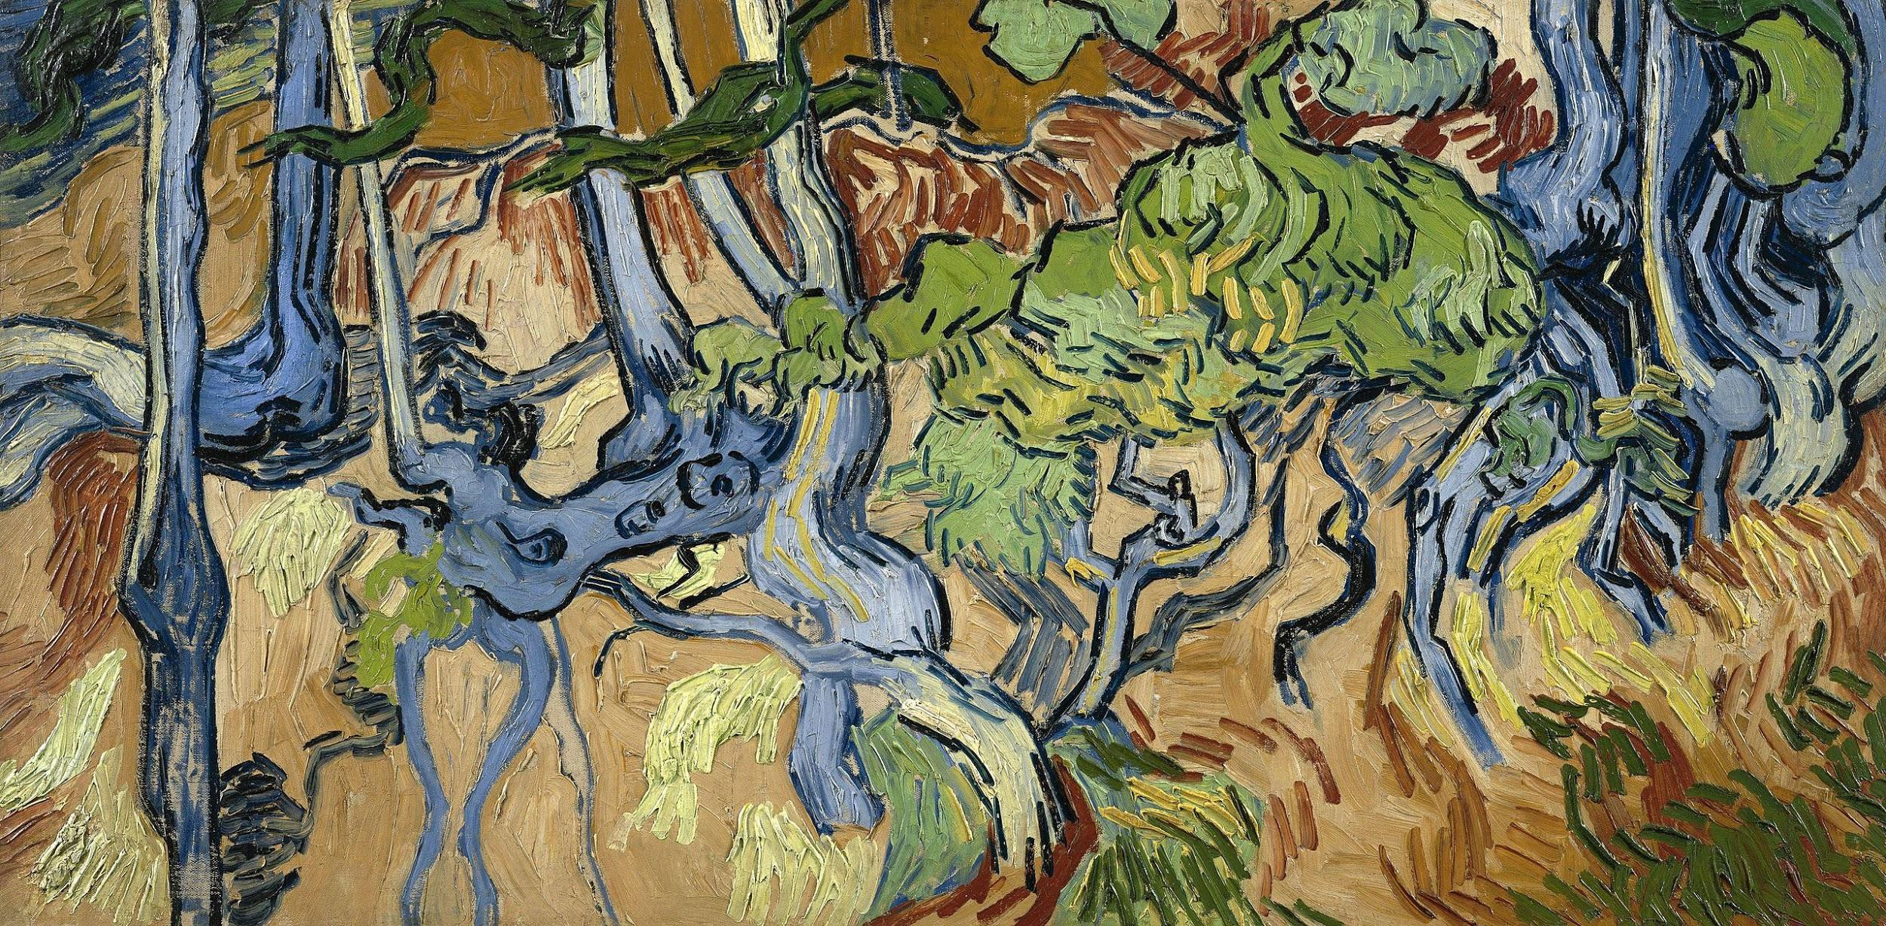
Original image is CC0 public domain
Starry Night and Tree Roots by Van Gogh are in the public domain Bokeh image is in the public domain
Stylized images copyright Justin Johnson, 2017; reproduced with permission
Gatys et al, “Image Style Transfer using Convolutional Neural Networks”, CVPR 2016 Gatys et al, “Controlling Perceptual Factors in Neural Style Transfer”, CVPR 2017
Figures copyright Justin Johnson, 2015. Reproduced with permission. Generated using the Inceptionism approach from a blog post by Google Research.
Fei-Fei Li & Justin Johnson & Serena Yeung Lecture 5 - April 18, 2017

Slide 25
Convolutional Neural Networks
(First without the brain stuff)
Fei-Fei Li & Justin Johnson & Serena Yeung Lecture 5 - April 18, 2017

Slide 26
Fully Connected Layer
32x32x3 image -> stretch to 3072 x 1
input
activation
1
1
10 x 3072
weights
3072
10
Fei-Fei Li & Justin Johnson & Serena Yeung Lecture 5 - April 18, 2017

Slide 27
Fully Connected Layer
32x32x3 image -> stretch to 3072 x 1
input
activation
1
1
10 x 3072
weights
3072
10
1 number:
the result of taking a dot product between a row of W and the input (a 3072-dimensional dot product)
Fei-Fei Li & Justin Johnson & Serena Yeung Lecture 5 - April 18, 2017

Slide 28
Convolution Layer
32x32x3 image -> preserve spatial structure
32
height
32
depth
width
3
Fei-Fei Li & Justin Johnson & Serena Yeung Lecture 5 - April 18, 2017

Slide 29
Convolution Layer
32x32x3 image
5x5x3 filter
32
Convolve the filter with the image
i.e. “slide over the image spatially, computing dot products”
32
3
Lecture 5 - 29
Fei-Fei Li & Justin Johnson & Serena Yeung Lecture 5 - April 18, 2017

Slide 30
Convolution Layer
Filters always extend the full depth of the input volume
32x32x3 image
5x5x3 filter
32
Convolve the filter with the image
i.e. “slide over the image spatially, computing dot products”
32
3
Lecture 5 - 30
Fei-Fei Li & Justin Johnson & Serena Yeung Lecture 5 - April 18, 2017

Slide 31

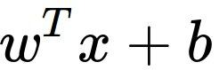
Convolution Layer
32x32x3 image 5x5x3 filter
32
1 number:
the result of taking a dot product between the filter and a small 5x5x3 chunk of the image
(i.e. 5*5*3 = 75-dimensional dot product + bias)
32
3
Lecture 5 - 31
Fei-Fei Li & Justin Johnson & Serena Yeung Lecture 5 - April 18, 2017

Slide 32
Convolution Layer
activation map
32x32x3 image 5x5x3 filter
32
28
convolve (slide) over all spatial locations
32
28
3
1
Lecture 5 - 32
Fei-Fei Li & Justin Johnson & Serena Yeung Lecture 5 - April 18, 2017

Slide 33
consider a second, green filter
Convolution Layer
32x32x3 image 5x5x3 filter
activation maps
32
28
convolve (slide) over all spatial locations
32
28
3
1
Lecture 5 - 33
Fei-Fei Li & Justin Johnson & Serena Yeung Lecture 5 - April 18, 2017

Slide 34
For example, if we had 6 5x5 filters, we’ll get 6 separate activation maps:
activation maps
32
28
Convolution Layer
32
28
3
6
We stack these up to get a “new image” of size 28x28x6!
Fei-Fei Li & Justin Johnson & Serena Yeung Lecture 5 - April 18, 2017

Slide 35
Preview: ConvNet is a sequence of Convolution Layers, interspersed with activation functions
32
28
CONV, ReLU
e.g. 6 5x5x3 filters
32
28
3
6
Fei-Fei Li & Justin Johnson & Serena Yeung Lecture 5 - April 18, 2017

Slide 36
Preview: ConvNet is a sequence of Convolutional Layers, interspersed with activation functions
32
28
24
….
CONV, ReLU
e.g. 6 5x5x3 filters
CONV, ReLU
e.g. 10 5x5x6 filters
CONV, ReLU
32
28
24
3
6
10
Fei-Fei Li & Justin Johnson & Serena Yeung Lecture 5 - April 18, 2017

Slide 37
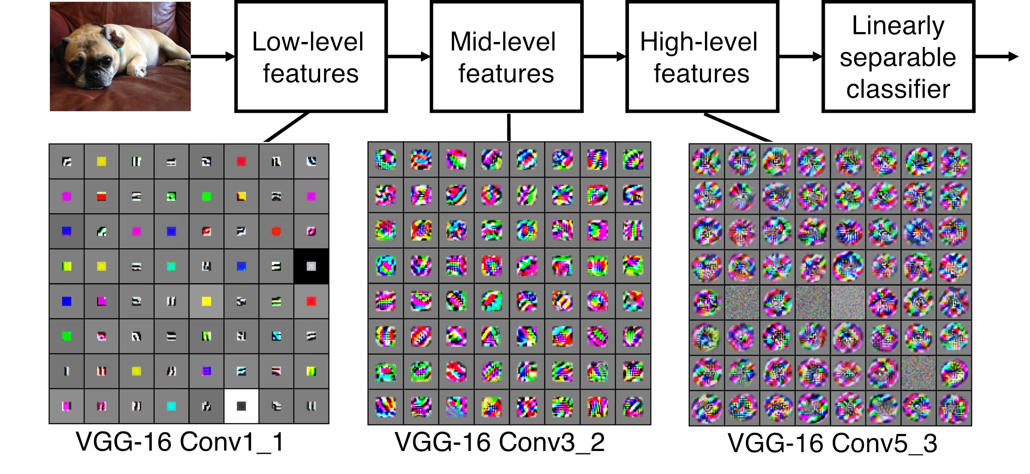
Preview
[Zeiler and Fergus 2013]
Visualization of VGG-16 by Lane McIntosh. VGG-16 architecture from [Simonyan and Zisserman 2014].
Fei-Fei Li & Justin Johnson & Serena Yeung Lecture 5 - April 18, 2017

Slide 38
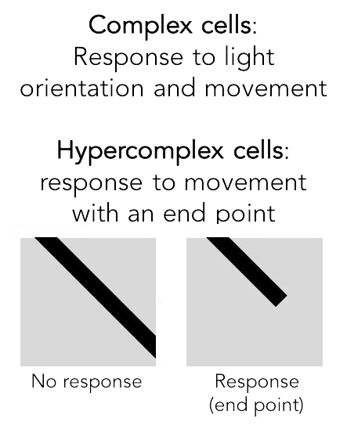
Preview
Fei-Fei Li & Justin Johnson & Serena Yeung Lecture 5 - April 18, 2017

Slide 39


one filter =>
one activation map
example 5x5 filters
(32 total)
We call the layer convolutional because it is related to convolution of two signals:
elementwise multiplication and sum of a filter and the signal (image)
Figure copyright Andrej Karpathy.
Fei-Fei Li & Justin Johnson & Serena Yeung Lecture 5 - April 18, 2017

Slide 40


preview:
Fei-Fei Li & Justin Johnson & Serena Yeung Lecture 5 - April 18, 2017

Slide 41
A closer look at spatial dimensions:
activation map
32x32x3 image 5x5x3 filter
32
28
convolve (slide) over all spatial locations
32
28
3
1
Fei-Fei Li & Justin Johnson & Serena Yeung Lecture 5 - April 18, 2017

Slide 42
A closer look at spatial dimensions:
7
7x7 input (spatially) assume 3x3 filter
7
Fei-Fei Li & Justin Johnson & Serena Yeung Lecture 5 - April 18, 2017

Slide 43
A closer look at spatial dimensions:
7
7x7 input (spatially) assume 3x3 filter
7
Fei-Fei Li & Justin Johnson & Serena Yeung Lecture 5 - April 18, 2017

Slide 44
A closer look at spatial dimensions:
7
7x7 input (spatially) assume 3x3 filter
7
Fei-Fei Li & Justin Johnson & Serena Yeung Lecture 5 - April 18, 2017

Slide 45
A closer look at spatial dimensions:
7
7x7 input (spatially) assume 3x3 filter
7
Fei-Fei Li & Justin Johnson & Serena Yeung Lecture 5 - April 18, 2017

Slide 46
A closer look at spatial dimensions:
7
7x7 input (spatially) assume 3x3 filter
=> 5x5 output
7
Fei-Fei Li & Justin Johnson & Serena Yeung Lecture 5 - April 18, 2017

Slide 47
A closer look at spatial dimensions:
7
7x7 input (spatially) assume 3x3 filter applied with stride 2
7
Fei-Fei Li & Justin Johnson & Serena Yeung Lecture 5 - April 18, 2017

Slide 48
A closer look at spatial dimensions:
7
7x7 input (spatially) assume 3x3 filter applied with stride 2
7
Fei-Fei Li & Justin Johnson & Serena Yeung Lecture 5 - April 18, 2017

Slide 49
A closer look at spatial dimensions:
7
7x7 input (spatially) assume 3x3 filter applied with stride 2
=> 3x3 output!
7
Fei-Fei Li & Justin Johnson & Serena Yeung Lecture 5 - April 18, 2017

Slide 50
A closer look at spatial dimensions:
7
7x7 input (spatially) assume 3x3 filter applied with stride 3?
7
Fei-Fei Li & Justin Johnson & Serena Yeung Lecture 5 - April 18, 2017

Slide 51
A closer look at spatial dimensions:
7
7x7 input (spatially) assume 3x3 filter applied with stride 3?
7
doesn’t fit!
cannot apply 3x3 filter on 7x7 input with stride 3.
Fei-Fei Li & Justin Johnson & Serena Yeung Lecture 5 - April 18, 2017

Slide 52
N
Output size:
(N - F) / stride + 1
 |  |  | F
 | F
e.g. N = 7, F = 3:
stride 1 => (7 - 3)/1 + 1 = 5
stride 2 => (7 - 3)/2 + 1 = 3
stride 3 => (7 - 3)/3 + 1 = 2.33 :\
N
Fei-Fei Li & Justin Johnson & Serena Yeung Lecture 5 - April 18, 2017

Slide 53
In practice: Common to zero pad the border
0 | 0 | 0 | 0 | 0 | 0
0
0
0
0
e.g. input 7x7
3x3 filter, applied with stride 1
pad with 1 pixel border => what is the output?
(recall:)
(N - F) / stride + 1
Fei-Fei Li & Justin Johnson & Serena Yeung Lecture 5 - April 18, 2017

Slide 54
In practice: Common to zero pad the border
0 | 0 | 0 | 0 | 0 | 0
0
0
0
0
e.g. input 7x7
3x3 filter, applied with stride 1
pad with 1 pixel border => what is the output?
7x7 output!
Fei-Fei Li & Justin Johnson & Serena Yeung Lecture 5 - April 18, 2017

Slide 55
In practice: Common to zero pad the border
0 | 0 | 0 | 0 | 0 | 0
0
0
0
0
e.g. input 7x7
3x3 filter, applied with stride 1
pad with 1 pixel border => what is the output?
7x7 output!
in general, common to see CONV layers with stride 1, filters of size FxF, and zero-padding with (F-1)/2. (will preserve size spatially)
e.g. F = 3 => zero pad with 1 F = 5 => zero pad with 2 F = 7 => zero pad with 3
Fei-Fei Li & Justin Johnson & Serena Yeung Lecture 5 - April 18, 2017

Slide 56
Remember back to…
E.g. 32x32 input convolved repeatedly with 5x5 filters shrinks volumes spatially! (32 -> 28 -> 24 ...). Shrinking too fast is not good, doesn’t work well.
32
28
24
….
CONV, ReLU
e.g. 6 5x5x3 filters
CONV, ReLU
e.g. 10 5x5x6 filters
CONV, ReLU
32
28
24
3
6
10
Fei-Fei Li & Justin Johnson & Serena Yeung Lecture 5 - April 18, 2017

Slide 57
Examples time:
Input volume: 32x32x3
10 5x5 filters with stride 1, pad 2
Output volume size: ?
Fei-Fei Li & Justin Johnson & Serena Yeung Lecture 5 - April 18, 2017

Slide 58
Examples time:
Input volume: 32x32x3
10 5x5 filters with stride 1, pad 2
Output volume size:
(32+2*2-5)/1+1 = 32 spatially, so
32x32x10
Fei-Fei Li & Justin Johnson & Serena Yeung Lecture 5 - April 18, 2017

Slide 59
Examples time:
Input volume: 32x32x3
10 5x5 filters with stride 1, pad 2
Number of parameters in this layer?
Fei-Fei Li & Justin Johnson & Serena Yeung Lecture 5 - April 18, 2017

Slide 60
Examples time:
Input volume: 32x32x3
10 5x5 filters with stride 1, pad 2
Number of parameters in this layer? each filter has 5*5*3 + 1 = 76 params
=> 76*10 = 760
(+1 for bias)
Fei-Fei Li & Justin Johnson & Serena Yeung Lecture 5 - April 18, 2017

Slide 61

Fei-Fei Li & Justin Johnson & Serena Yeung Lecture 5 - April 18, 2017

Slide 62
Common settings:
K = (powers of 2, e.g. 32, 64, 128, 512)
- F = 3, S = 1, P = 1
- F = 5, S = 1, P = 2
- F = 5, S = 2, P = ? (whatever fits)
- F = 1, S = 1, P = 0
Fei-Fei Li & Justin Johnson & Serena Yeung Lecture 5 - April 18, 2017

Slide 63
(btw, 1x1 convolution layers make perfect sense)
1x1 CONV
with 32 filters
56
56
(each filter has size 1x1x64, and performs a 64-dimensional dot product)
56
56
64
32
Fei-Fei Li & Justin Johnson & Serena Yeung Lecture 5 - April 18, 2017

Slide 64


Example: CONV layer in Torch
Torch is licensed under BSD 3-clause.
Fei-Fei Li & Justin Johnson & Serena Yeung Lecture 5 - April 18, 2017

Slide 65

Example: CONV layer in Caffe
Caffe is licensed under BSD 2-Clause.
Fei-Fei Li & Justin Johnson & Serena Yeung Lecture 5 - April 18, 2017

Slide 66
The brain/neuron view of CONV Layer
32x32x3 image 5x5x3 filter
32
1 number:
the result of taking a dot product between the filter and this part of the image
(i.e. 5*5*3 = 75-dimensional dot product)
32
3
Fei-Fei Li & Justin Johnson & Serena Yeung Lecture 5 - April 18, 2017

Slide 67
The brain/neuron view of CONV Layer
32x32x3 image 5x5x3 filter
32
It’s just a neuron with local connectivity...
1 number:
the result of taking a dot product between the filter and this part of the image
(i.e. 5*5*3 = 75-dimensional dot product)
32
3
Fei-Fei Li & Justin Johnson & Serena Yeung Lecture 5 - April 18, 2017

Slide 68
The brain/neuron view of CONV Layer
32
28
An activation map is a 28x28 sheet of neuron outputs:
Each is connected to a small region in the input
All of them share parameters
32
28
“5x5 filter” -> “5x5 receptive field for each neuron”
3
Fei-Fei Li & Justin Johnson & Serena Yeung Lecture 5 - April 18, 2017

Slide 69
The brain/neuron view of CONV Layer
32
E.g. with 5 filters,
CONV layer consists of neurons arranged in a 3D grid (28x28x5)
28
There will be 5 different neurons all looking at the same region in the input volume
32
28
3
5
Fei-Fei Li & Justin Johnson & Serena Yeung Lecture 5 - April 18, 2017

Slide 70
Reminder: Fully Connected Layer
Each neuron looks at the full input volume
32x32x3 image -> stretch to 3072 x 1
input
activation
1
1
10 x 3072
weights
3072
10
1 number:
the result of taking a dot product between a row of W and the input (a 3072-dimensional dot product)
Fei-Fei Li & Justin Johnson & Serena Yeung Lecture 5 - April 18, 2017

Slide 71
two more layers to go: POOL/FC
Fei-Fei Li & Justin Johnson & Serena Yeung Lecture 5 - April 18, 2017

Slide 72

Pooling layer
makes the representations smaller and more manageable
operates over each activation map independently:
Fei-Fei Li & Justin Johnson & Serena Yeung Lecture 5 - April 18, 2017

Slide 73
MAX POOLING
Single depth slice
1 | 1 | 2 | 4
5 | 6 | 7 | 8
3 | 2 | 1 | 0
1 | 2 | 3 | 4
x
max pool with 2x2 filters and stride 2
6 | 8
3 | 4
y
Fei-Fei Li & Justin Johnson & Serena Yeung Lecture 5 - April 18, 2017

Slide 74

Fei-Fei Li & Justin Johnson & Serena Yeung Lecture 5 - April 18, 2017

Slide 75
Common settings:
F = 2, S = 2
F = 3, S = 2
Fei-Fei Li & Justin Johnson & Serena Yeung Lecture 5 - April 18, 2017

Slide 76
Fully Connected Layer (FC layer)
- Contains neurons that connect to the entire input volume, as in ordinary Neural Networks
Fei-Fei Li & Justin Johnson & Serena Yeung Lecture 5 - April 18, 2017

Slide 77


[ConvNetJS demo: training on CIFAR-10]
http://cs.stanford.edu/people/karpathy/convnetjs/demo/cifar10.html
Fei-Fei Li & Justin Johnson & Serena Yeung Lecture 5 - April 18, 2017

Slide 78
Summary
ConvNets stack CONV,POOL,FC layers
Trend towards smaller filters and deeper architectures
Trend towards getting rid of POOL/FC layers (just CONV)
Typical architectures look like
[(CONV-RELU)*N-POOL?]*M-(FC-RELU)*K,SOFTMAX
where N is usually up to ~5, M is large, 0 <= K <= 2.
- but recent advances such as ResNet/GoogLeNet challenge this paradigm
Fei-Fei Li & Justin Johnson & Serena Yeung Lecture 5 - April 18, 2017

